Slide 1
3. Papiloedema
The challenge …
Increase of demand for papilledema from Optometrist, GPs, and YB
High rate of false positives 90 % ONLY 1:10 REAL papiloedema
Loosing capacity
> 50% in GPCC follow up

Slide 2
The positive side …
Effective screening
n=133
90% Discharged
4.5% Real
Grading score /management already set up with Neuro at L&D.
Multimodal imaging availability at L&D to categorize risk and triage.

Slide 3
Referrals (Optom, GPS, YB)
Triage
PAP Screening
Incidental 2w
Symptoms <1w
Diagnostics
Assessment
Stage 1
Nurse
Visual Acuity
Risk Questionnaire
Notes to be reviewed by Acute doctor same day
Stage 2
Technician
Visual Field
Stage 3
Technician
Multicolor
OCT raster and RNFL
Autoflorescence

Slide 4
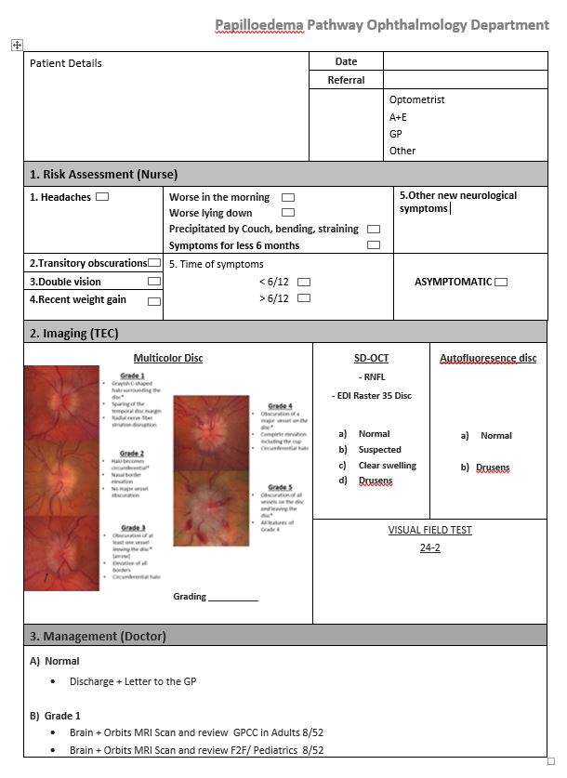
Stage 1
Diagnostic
Stage 2-3
Assessment

Slide 5
