Slide 1
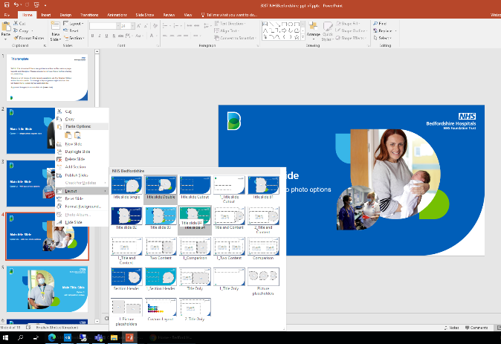
This template
Within this document there are guidance notes on the various page layouts and designs. Please ensure to remove these before sharing or presenting.
There is a full range of slide layouts available via the ‘Master Slides’ within this document. To change a layout please right click on the left hand menu, select layout and click which you need. Please do not stretch pictures, if you need to resize
Approved imagery is accessible on the intranet.

Slide 2
Main Title Slide
Option 1 – single photo square size

Slide 3
Main title Slide
Option 2 – with two photo options

Slide 4
Main title Slide
Option 2a – with two photo options

Slide 5
Main Title Slide
Option 3 with tall portrait picture

Slide 6
Main Title Slide
Option 4 – with tall portrait picture

Slide 7
Main Title Slide
Option 5 – with tall portrait picture

Slide 8
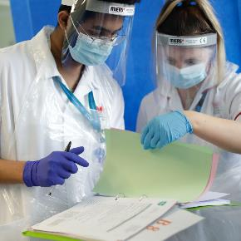
Main Title Slide
Option 6 – with cutout picture in the B

Slide 9
Section Break (option 1)
This section contains the following:
More points
or details
here

Slide 10
Section Break (option 2)
This section contains the following:
More points
or details
here

Slide 11
One-picture text slide
To change the photo, left click it and press backspace to delete it.
You’ll get a grey shape instead.
Left click the icon in the centre, to open Explorer, and you can find the picture you’d like to insert.

Slide 12
Two-picture text slide
To change the photo, left click it and press backspace to delete it.
You’ll get a grey shape instead.
Left click the icon in the centre, to open Explorer, and you can find the picture you’d like to insert.

Slide 13
Two-picture text slide
To change the photo, left click it and press backspace to delete it.
You’ll get a grey shape instead.
Left click the icon in the centre, to open Explorer, and you can find the picture you’d like to insert.

Slide 14
One-picture text slide (standard format)
To change the photo, left click it and press backspace to delete it.
You’ll get a grey shape instead.
Left click the icon in the centre, to open Explorer, and you can find the picture you’d like to insert.

Slide 15
One-picture text slide (standard format)
To change the photo, left click it and press backspace to delete it.
You’ll get a grey shape instead.
Left click the icon in the centre, to open Explorer, and you can find the picture you’d like to insert.

Slide 16
Blank Text Only Slide
If you need more room for lots of text, this slide has no pictures
Bullet point style
More points…

Slide 17
Title
Table | Format

Slide 18
Colours
These are the colours on our corporate palette – they’re the same as the main NHS brand.
If you’d like to use different colours, you should use the those on the top two rows first, then the ones below if you need.
Please refer to the brand guidelines if needed.

