Slide 1
Welcome to our poster template!
The Communications Team receives more requests for posters than almost
any other product.
The poster isn’t necessarily the perfect solution to serve every possible need, but we do understand that sometimes it’s the right thing.

Slide 2
We see a lot of examples where colleagues who want to promote something locally, or raise awareness, have had a try themselves, with mixed results.
So, we have created a series of templates for colleagues to download and use.
The ideal poster should feature very few words and be clear on what it’s trying to tell, or ask the audience.
But, we know that sometimes, “posters” are also used to relay a lot of information, so we’ve created templates for those too.

Slide 3
Within this document there are guidance notes on the various page layouts and designs. Please ensure to remove these before sharing or presenting.
The content used in the following pages is indicative to show how the templates work, so please remove this.
There is a full range of slide layouts available via the ‘Master Slides’ within this document. To change a layout please right click on the left hand menu, select layout and click which you need.
You can use the photos in here already (or your own), but we have a whole library more on our intranet.

Slide 4
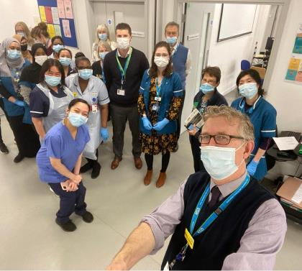
May Team of the Month
Vaccination Hubs
Nominations for June open: staffawards@ldh.nhs.uk

Slide 5
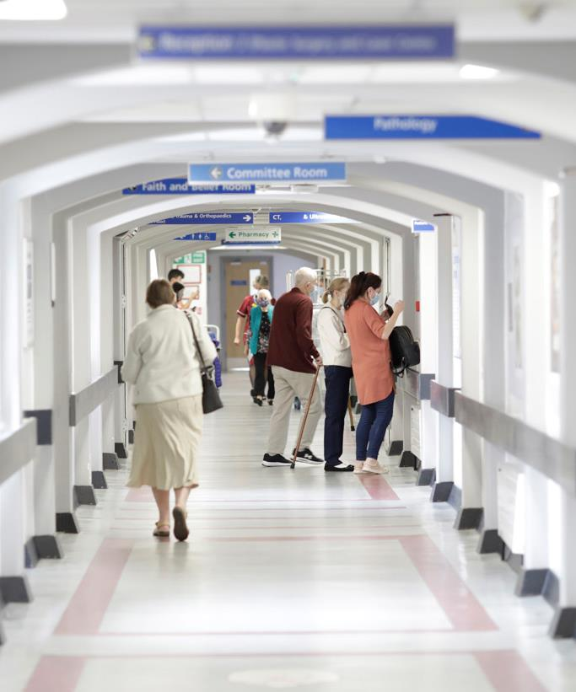
Friends & Family Test
Tell us what you think of your care by completing etc etc etc

Slide 6
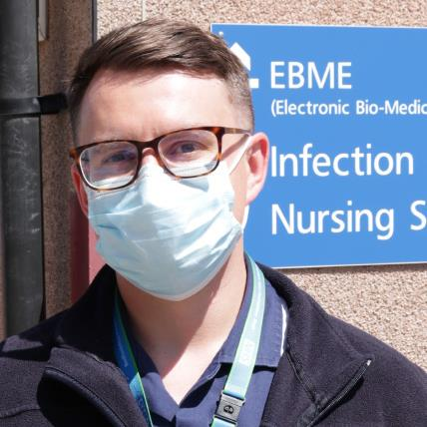
Test yourself twice a week. Every week.
“1 in 3 people with COVID-19 don’t have symptoms. Every case we find with lateral flow testing helps protect our patients, colleagues, friends and families.”
Jack O’Regan, Senior IPC Nurse

Slide 7
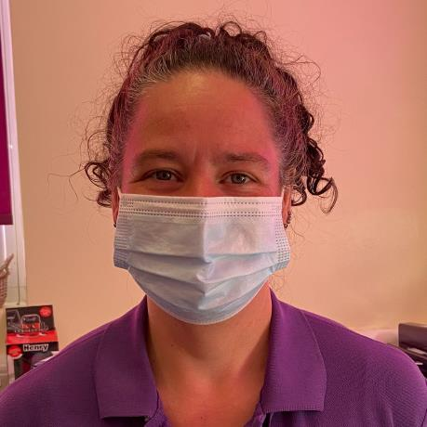
Test yourself twice a week. Every week.
Amanda Roberts,
Neonatal Community Sister
“I do regular lateral flow tests to protect the vulnerable babies I look after. It gives me peace of mind.”

Slide 8
Talk to our Learning Disability Liaison Nurses
This Learning Disability Awareness Week…
If you’d like support in improving care for patients with a learning disability, contact Simone or Evelyn at Bedford or Juliet or Jeanette at the L&D

Slide 9
Need to talk?
We’re listening
Giam quaest quam, ut poratem sus et eum sam consect urenit inciissi consed unt voluptatis aut etur.
Monday - Os nulpa sitet que corporia
Tuesday - Wulpa sitet que corporia corrupiciet quia
Wednesday - Oitet que corporia corrupiciet quia
Thursday - Fas nulpa sitet que corporia corrupiciet quia
Friday - Nulpa sitet que corporia corrupiciet quia
Date | Time | Venue
Friday 6 November | 18:00-00:00 | 3rd floor landing, tower block
Sunday 8 November | 11:00-19:30 | 3rd floor landing, tower block
Monday 9 November | 18:00-21:00 | 5th floor landing, tower block
Thursday 12 November | 18:00-00:00 | 3rd floor landing, tower block
Friday 13 November | 18:00-00:00 | 2nd floor landing, tower block
Saturday 14 November | 11:00-19:30 | 3rd floor landing, tower block
Monday 16 November | 18:00-00:00 | 5th floor landing, tower block
Thursday 19 November | 18:00-00:00 | 3rd floor landing, tower block
Saturday 21 November | 11:00-19:30 | 3rd floor landing, tower block
Thursday 26 November | 18:00-00:00 | 2nd floor landing, tower block
Friday 27 November | 18:00-00:00 | 3rd floor landing, tower block

Slide 10
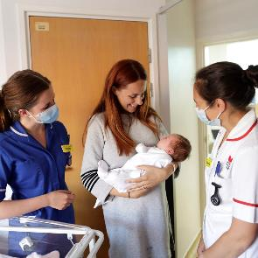
We’re listening
Need to talk?
Subheading
Ipsant etusame eseditiae magniet pa vent moluptiis adipsus dolum es in ped quasi reiur molupta tuscide rionsedi bera nonsed quiquodit, optur, vit delicip ienestia autem sit, te volum essum consed milit que volestrum elicaeptatem aces ulla vel.
Quis ent, consed eossim excerum nam repellab id quae pe voles que parias delit prae. Et aut hici re consequo laut as moluptatem si vent.
Call to action
Ipsant etusame eseditiae

Slide 11
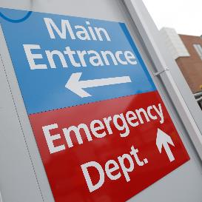
We’re short on space
as we improve your Emergency Department
So, to allow social distancing, for your safety, and that of our patients, we regretfully cannot allow visitors at this time.

Slide 12
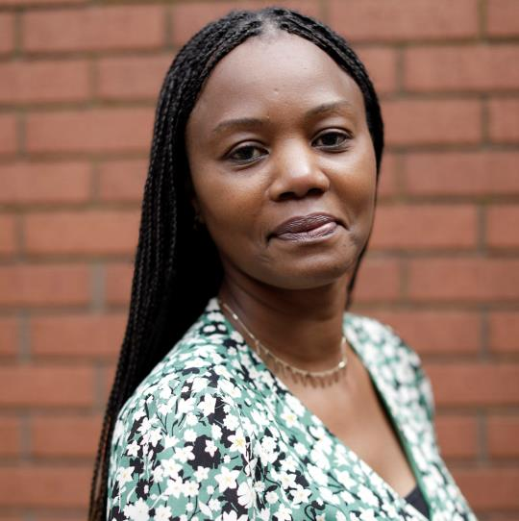
Marking Black History Month
Name here Role here
I’ve worked in the NHS for 14 years now and feel, besides being a mother, it’s the most rewarding and necessary job I’ve ever done. Black history is every month for me.

Slide 13
Mealtimes Matter
We are proud to operate a Protected Mealtime dining environment, so patients are not disturbed during meal times.
For more information, please ask ward staff

Slide 14
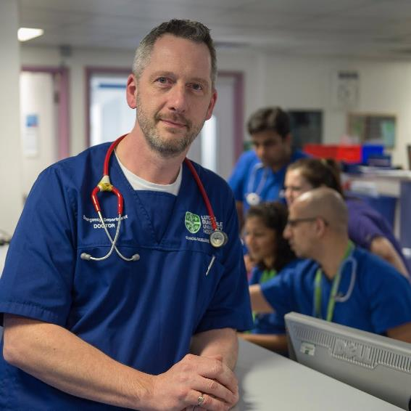
A great place to work
Join our ED department

Slide 19
