Slide 1
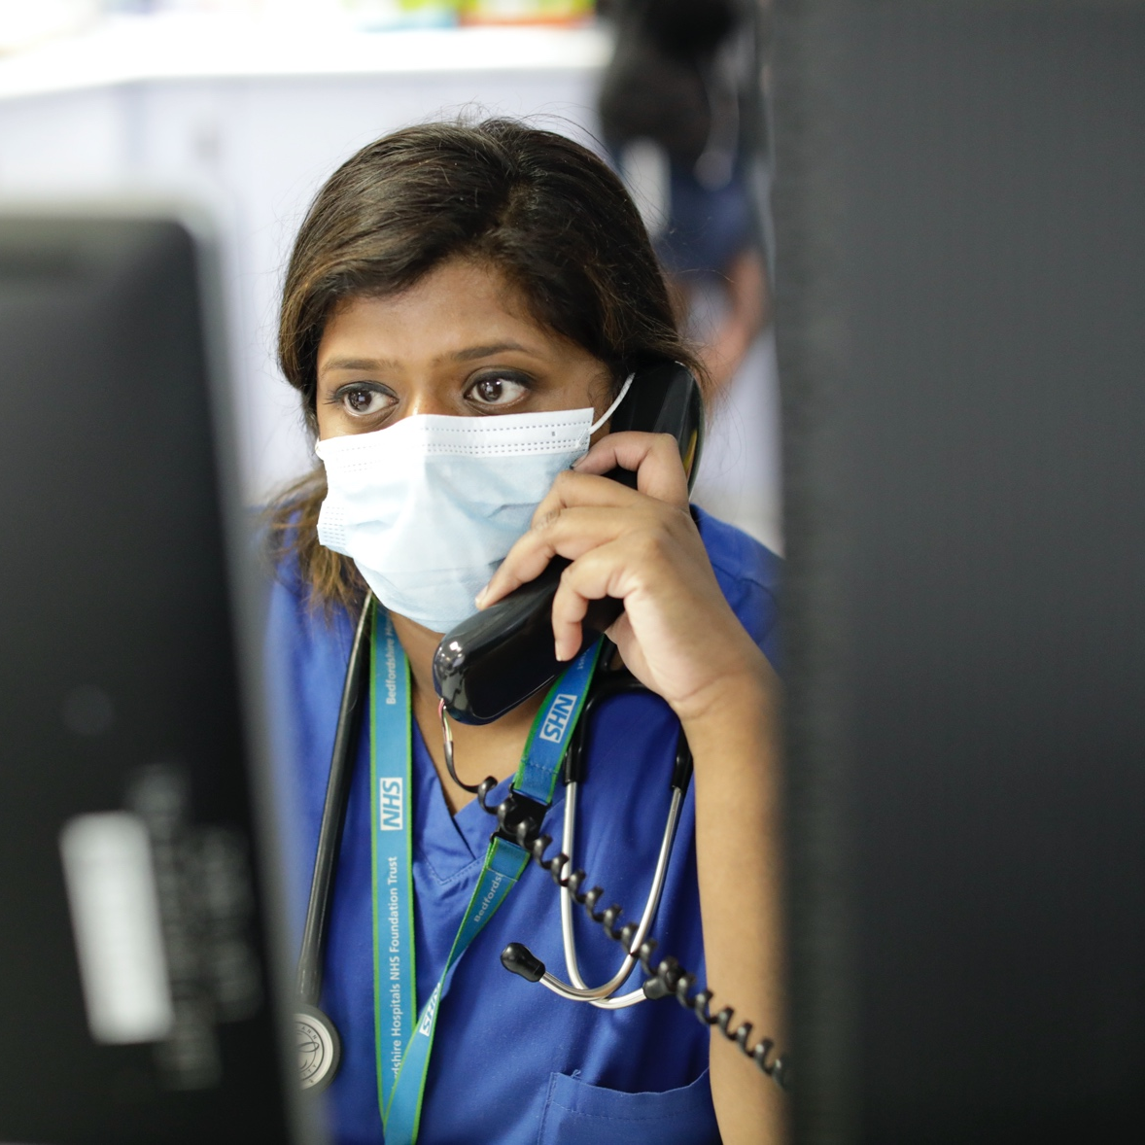
Welcome to Bedfordshire Hospitals NHS Foundation Trust Annual Members’ Meeting
8 September 2021

Slide 2
Welcome from the Chair
Simon Linnett

Slide 3
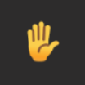
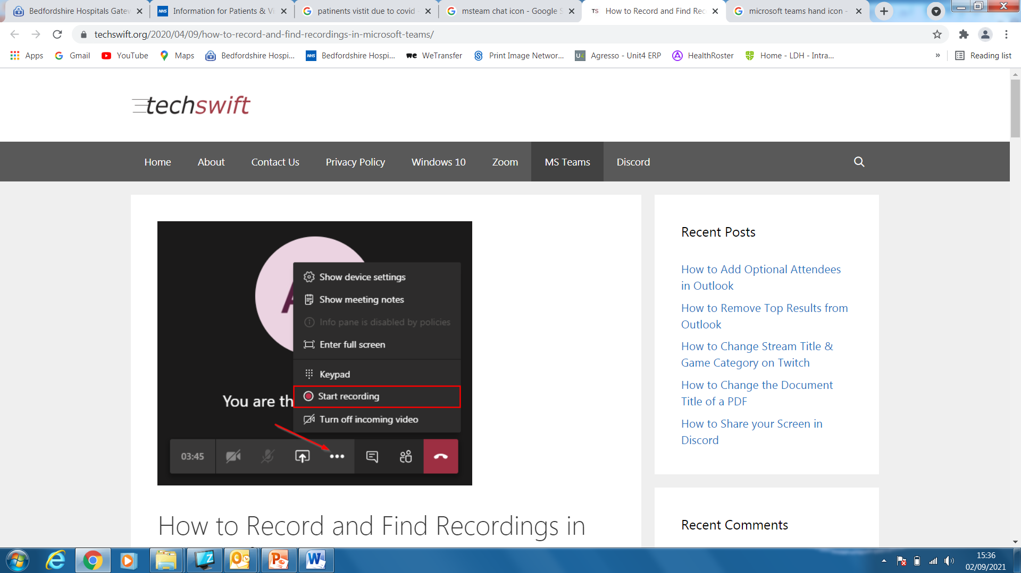
Question Time Preparation
Any questions you think of during the meeting you can :
text your question with your full name to 07812 493447
Use the ‘Raise the hand’ icon
Use the Meeting ‘chat’ icon - Type using the ‘chat’ facility to ask a question.
Please turn your camera OFF and MUTE your microphone (this will improve transmission quality and reduce background noise).
Please note – this meeting is being recorded
Disconnected? – If for some reason you are kicked out of the meeting you can REJOIN

Slide 4
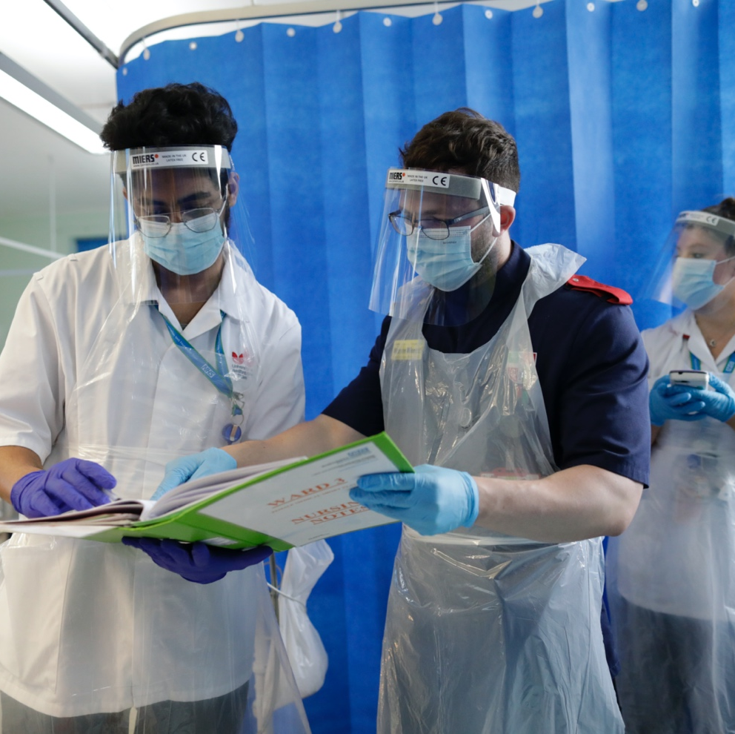
AGENDA
Report from Bedfordshire Hospitals NHS Foundation Trust 2020/21
Report from External Audit KPMG
Bedfordshire Hospitals NHS Foundation Trust 2021/22
Report from the Board of Directors
Report from the Governors
Question & Answer

Slide 5
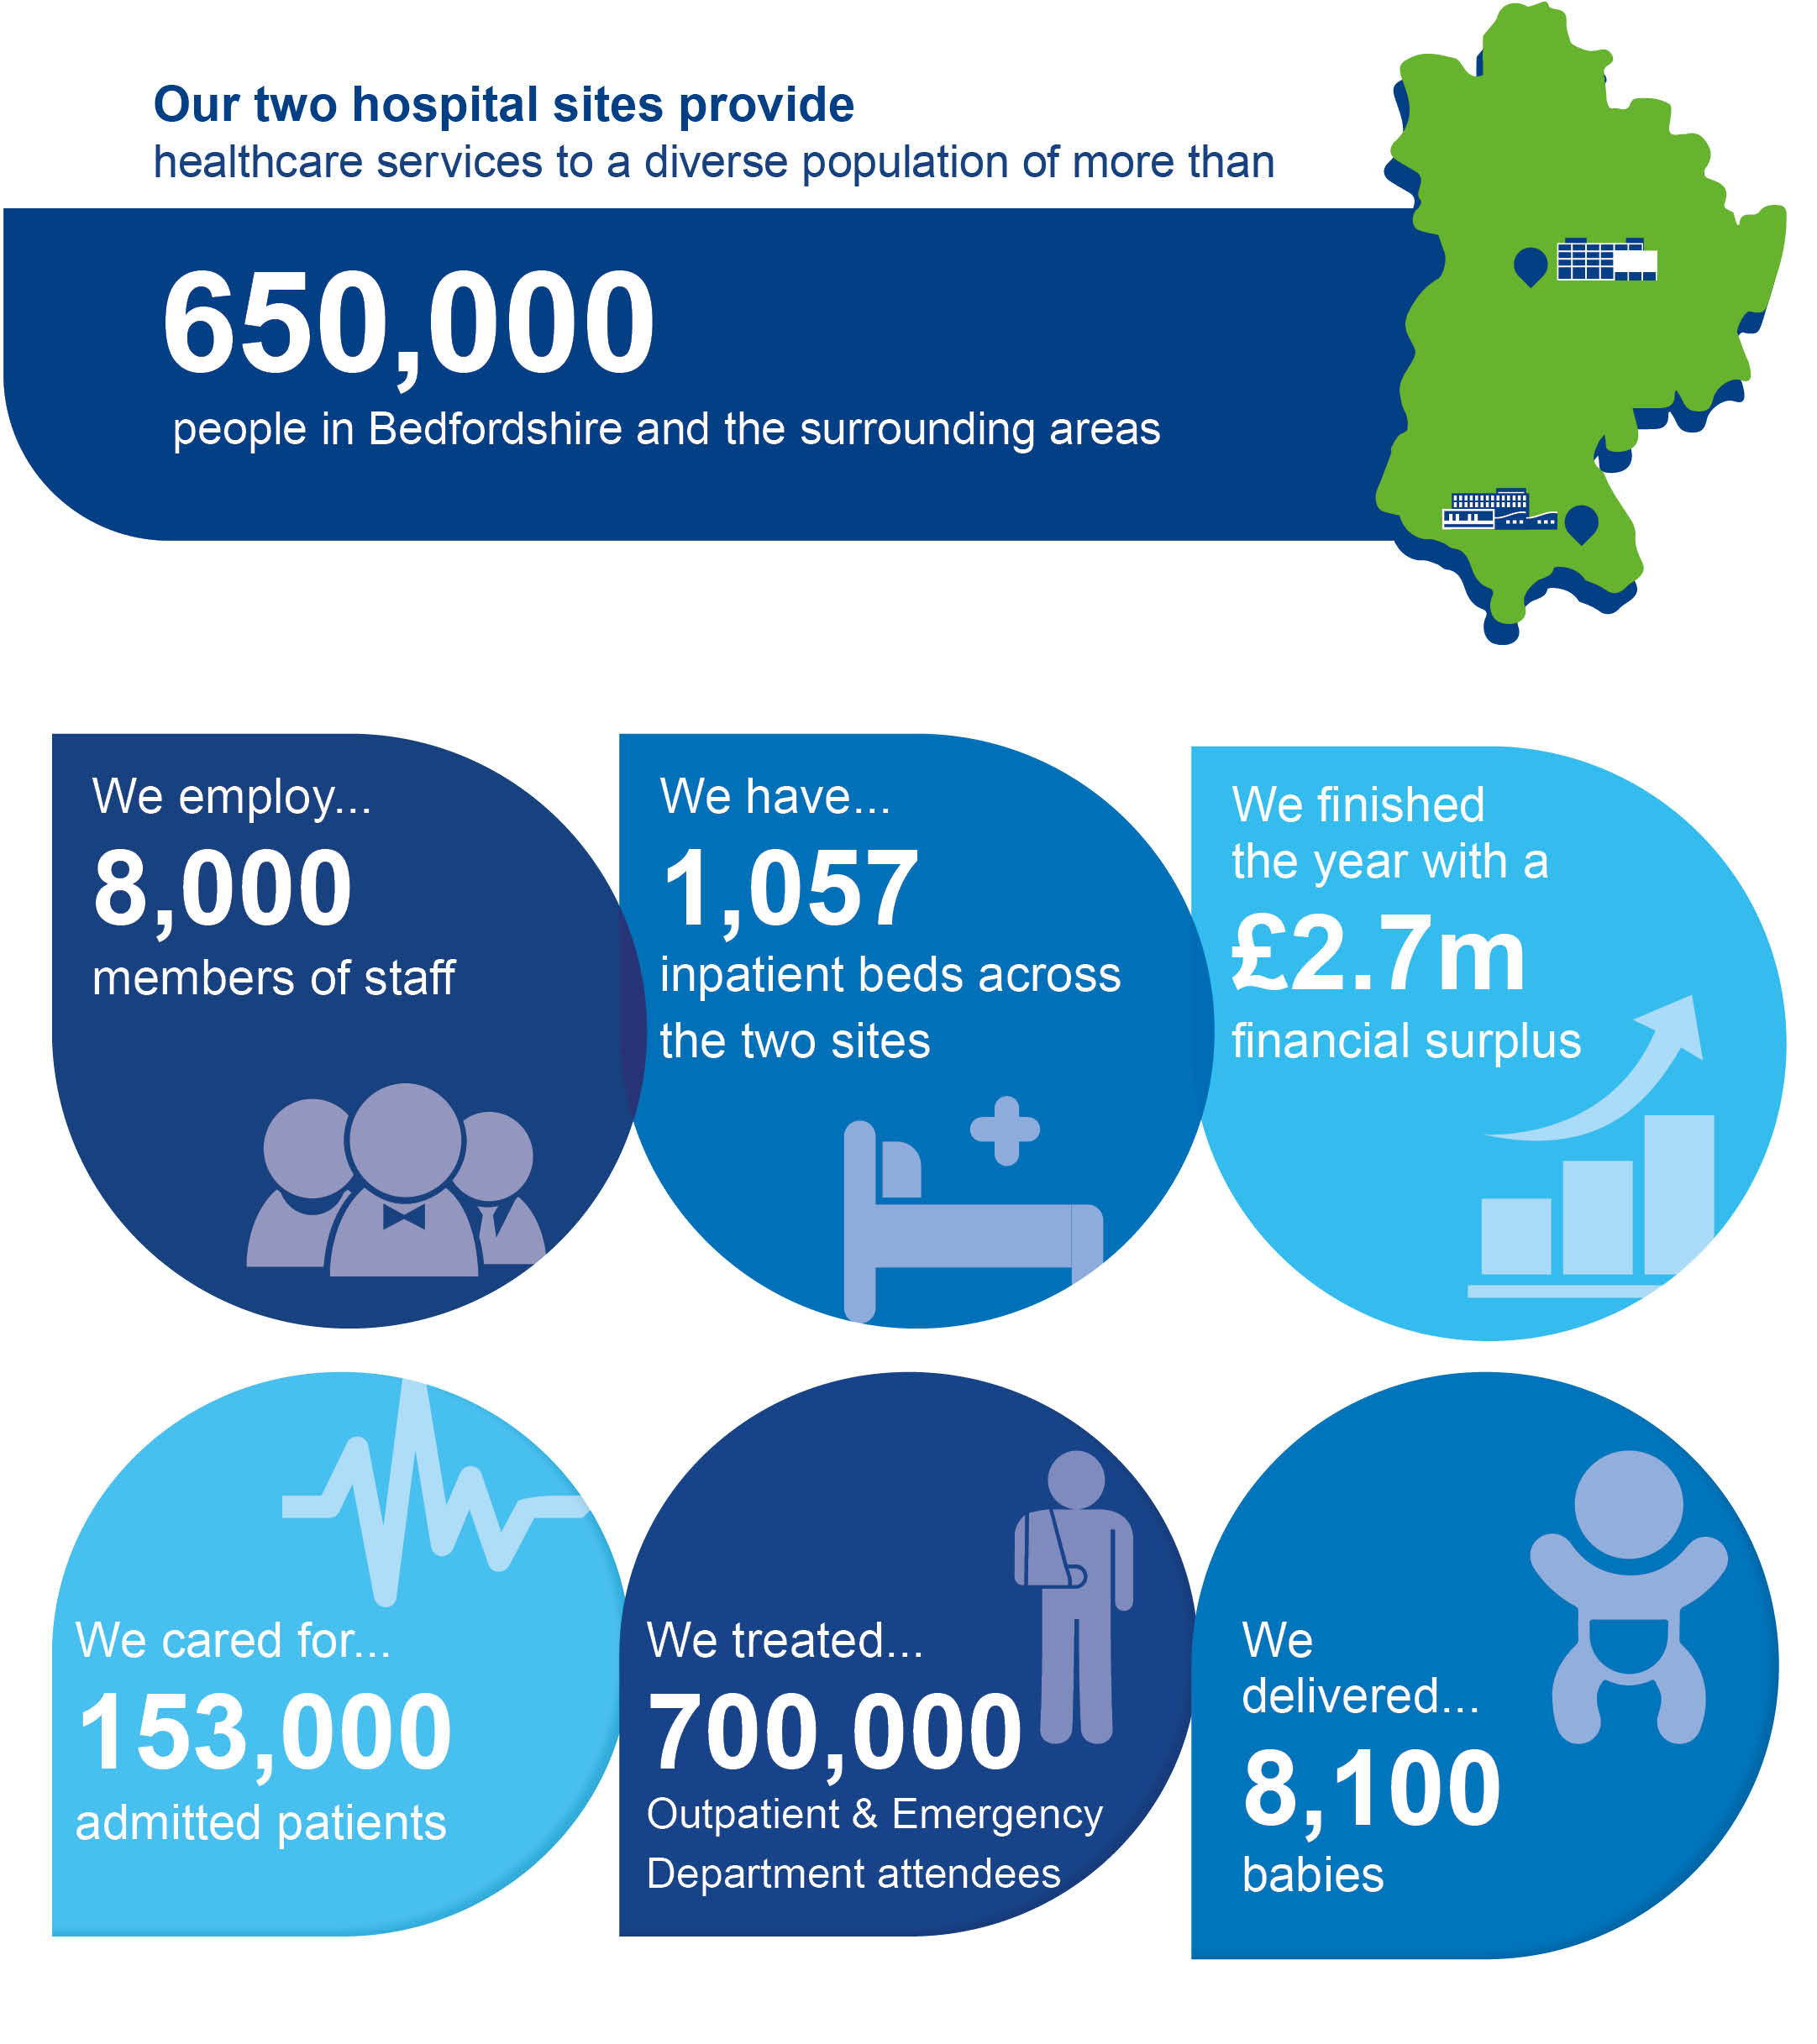
Year in
numbers

Slide 6
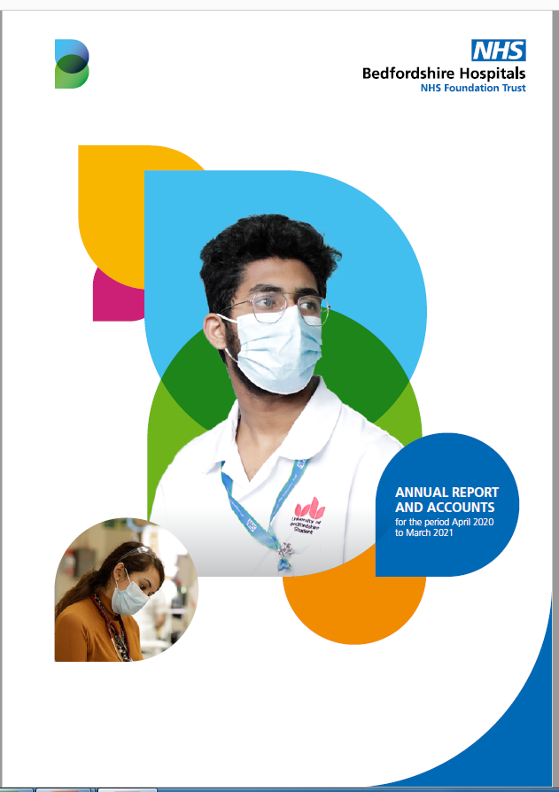
Bedfordshire Hospitals NHS Foundation Trust 2021/22
Completed the first year as Bedfordshire Hospitals NHS Foundation Trust
Operated the year under Covid 19 pressures
Continued integration following the merger
Continued to support staff health and wellbeing
Achieved a financial surplus
Completed and initiated significant redevelopment on both sites
Challenging CQC Maternity Report for Bedford Site
Continued to play a leading role in the Integrated Care System

Slide 7
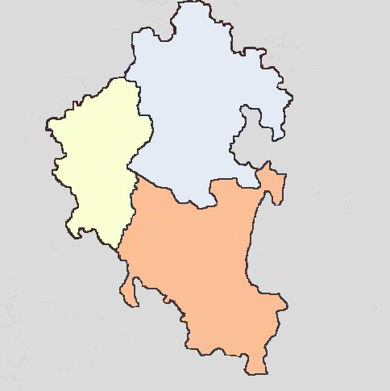
Patient Flows
The above map shows the catchments of the three hospitals within BLMK. The arrows demonstrate our flows from Buckinghamshire and Hertfordshire
Northampton
Bedford
H
Kempston
Biggleswade
Milton
Keynes
H
Ampthill
Toddington
Hitchin
Leighton
Buzzard
H
H
Luton
Stevenage
Aylesbury
Hemel
Hempstead
St Albans
Next slide – David Carter, Chief Executive

Slide 8
Review of 2020/21
David Carter
Chief Executive
Please turn your camera OFF and MUTE your microphone (this will improve transmission quality and reduce background noise).

Slide 9
Merger and Integration
The transition to the new organisation progressed smoothly despite Covid
Integration has progressed:
  Cross site leadership in place (consultant clinical directors, lead nurses and general managers)
  Cross site quality and patient safety team
  Service Integration Strategies in development with clinical teams
  Digital Strategy completed

Slide 10
Examples of Merger Benefits
Mutual aid during Covid e.g. PPE
Recruitment of clinical staff has improved
Shared learning from incidents across site
Financial savings (e.g. single financial ledger)
Insourcing of pathology at Bedford site back from the private sector
Flexibility to deal with waiting list long-waiters on either site
Balancing of critical care demand between the two sites

Slide 11
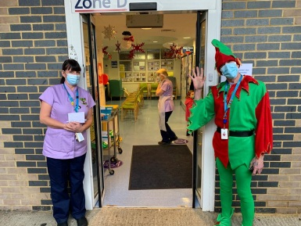

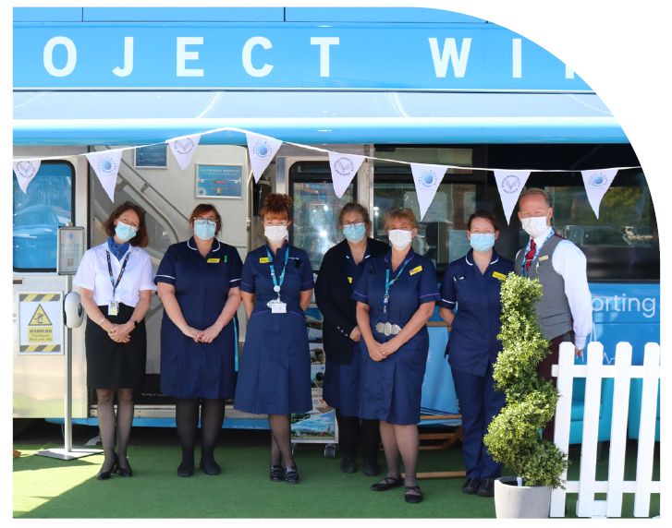
Staff Health and Wellbeing

Slide 12
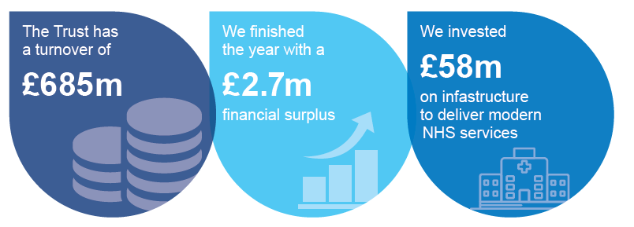
Finance
Achieved a financial surplus for the 22nd year (first as a new merged Trust)
Next slide – External Audit – Steve Hone, NED, Katie Scott, KPMG

Slide 13
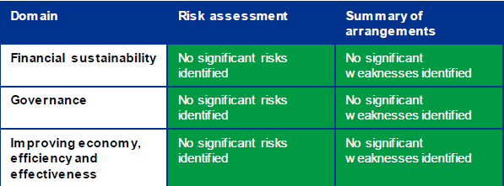
External Audit Report – Financial Audit
The Trust Annual Report and Accounts relating to its financial activities and operational audited by KPMG.
The External Auditors were able to:
Provide an unqualified report on the financial statements including the Annual Report
Provide an unqualified opinion in respect of value for money
The reports do not identify any material concerns and demonstrates that the Trust has good processes and controls in place.
Next slide – Cathy Jones, Deputy Chief Executive

Slide 14
COVID-19 - Managing Coronavirus
Greatest health emergency in NHS history
Support in place for the staff – wellbeing hubs
Excellent community engagement
Completed extensive vaccination programme for NHS Staff
Participated in Recovery Accelerator Programme
Ongoing BAU systems and processes

Slide 15
COVID-19 - Prevalence
March 2020
August 2020
Jan 2020
May 2021
August 2021
Green – Luton
Light Blue – Bedford
Dark Blue – Central Bedfordshire

Slide 16
Current Covid Position
31 positive inpatients at Bedford Hospital and 37 at L&D Hospital, 11 of which are critical care
No impact on recovery work from Covid patients; flows separated including ITU
Challenges with patients having to isolate after contact, or swabbing positive pre-operatively so missing scheduled dates
Staffing absence impacting diagnostics and outpatients; priority to protect theatres and day cases
Non-Covid urgent and emergency care pressures continue to escalate and both EDs extremely busy with record breaking days in recent months

Slide 17
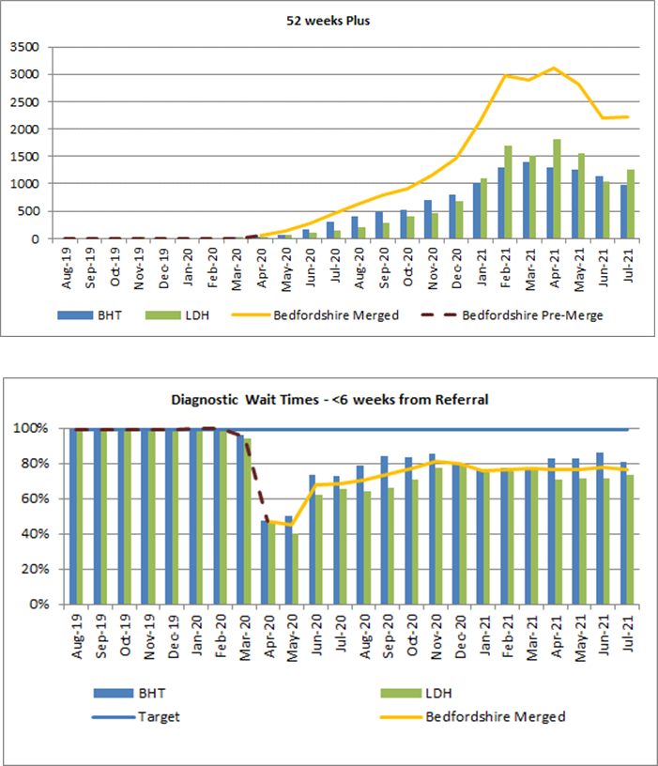
Recovery and Accelerator update
Patients waiting 52+ weeks following routine GP referral
Excellent engagement from clinicians and staff
Our accelerator focus was on elective and inpatient demand as this is the most complex capacity to provide
High staff absence due to Covid made it difficult to maintain performance through whole of July, but late June / early July delivered 98% of daycase and 106% of elective activity compared to equivalent weeks in 19/20
We are submitting a number of case studies as an ICS
Number of patients waiting over 52 weeks on a planned care pathway is over 2,200 and diagnostic waiting times continue to be challenged compared to pre-Covid performance
% patients having routine diagnostic tests within 6 weeks
Next slide – Liz Lees, Chief Nurse

Slide 18
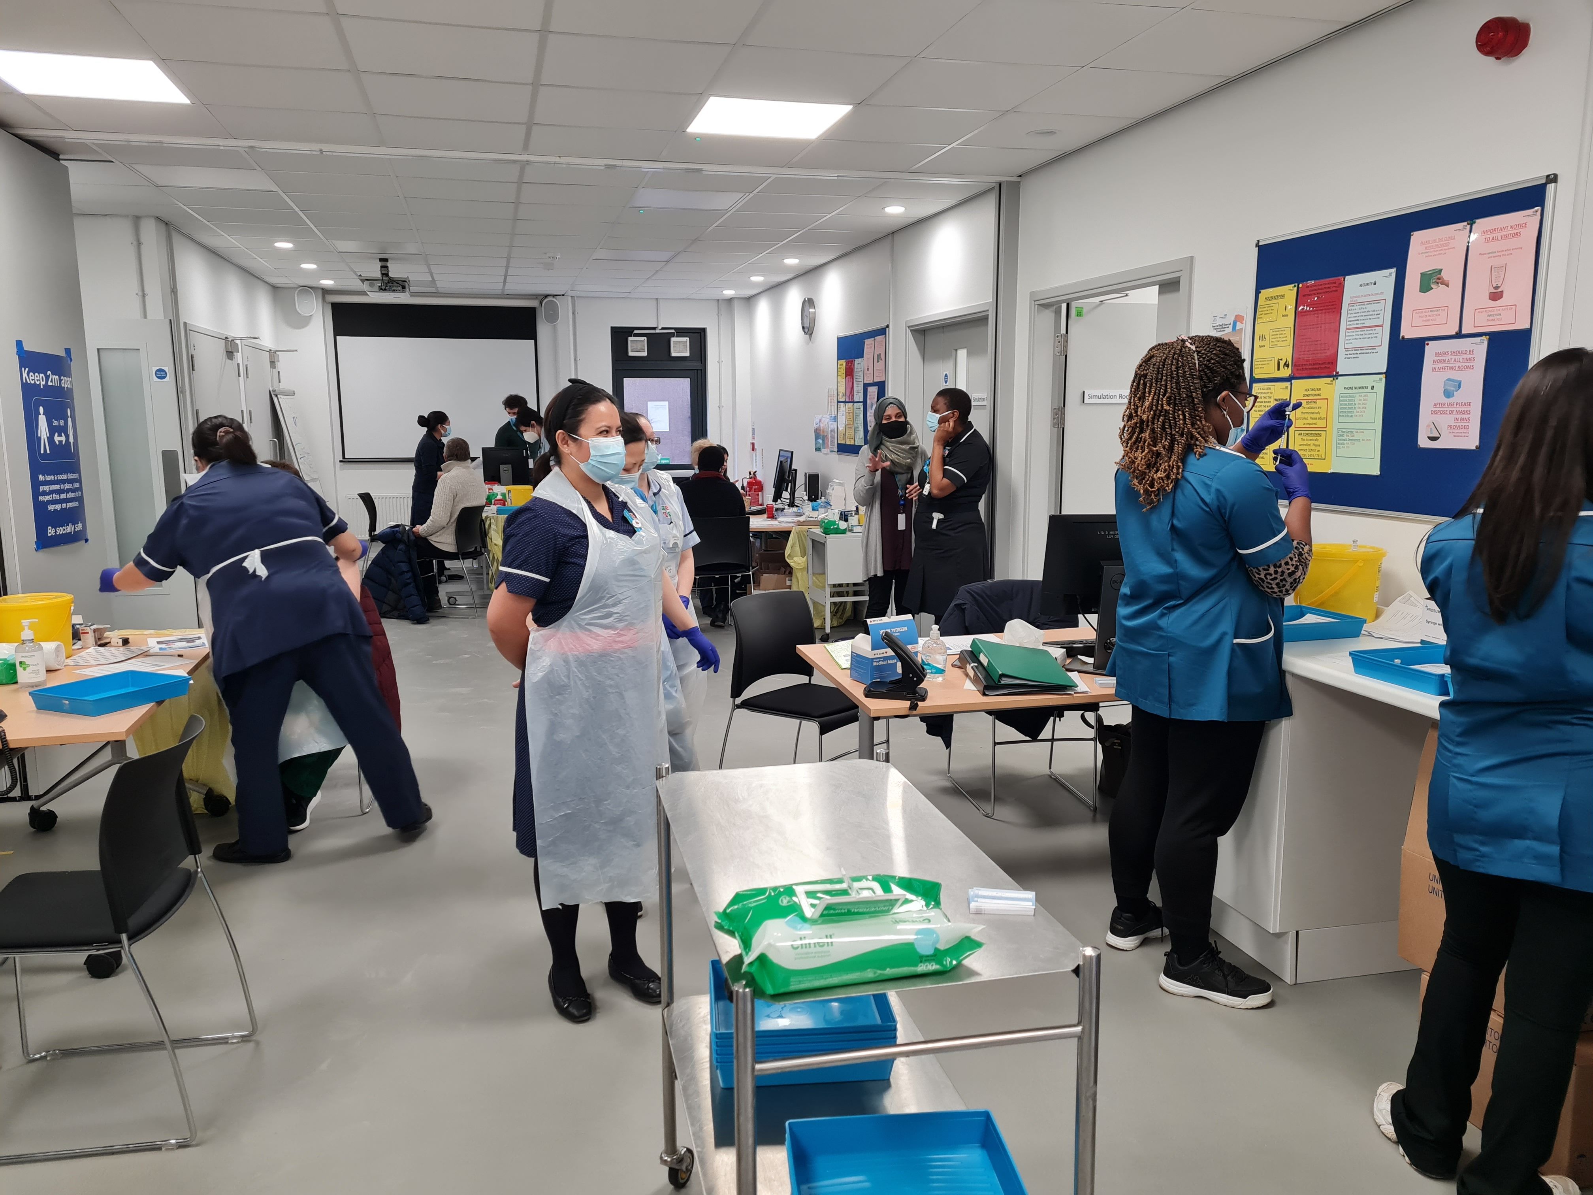
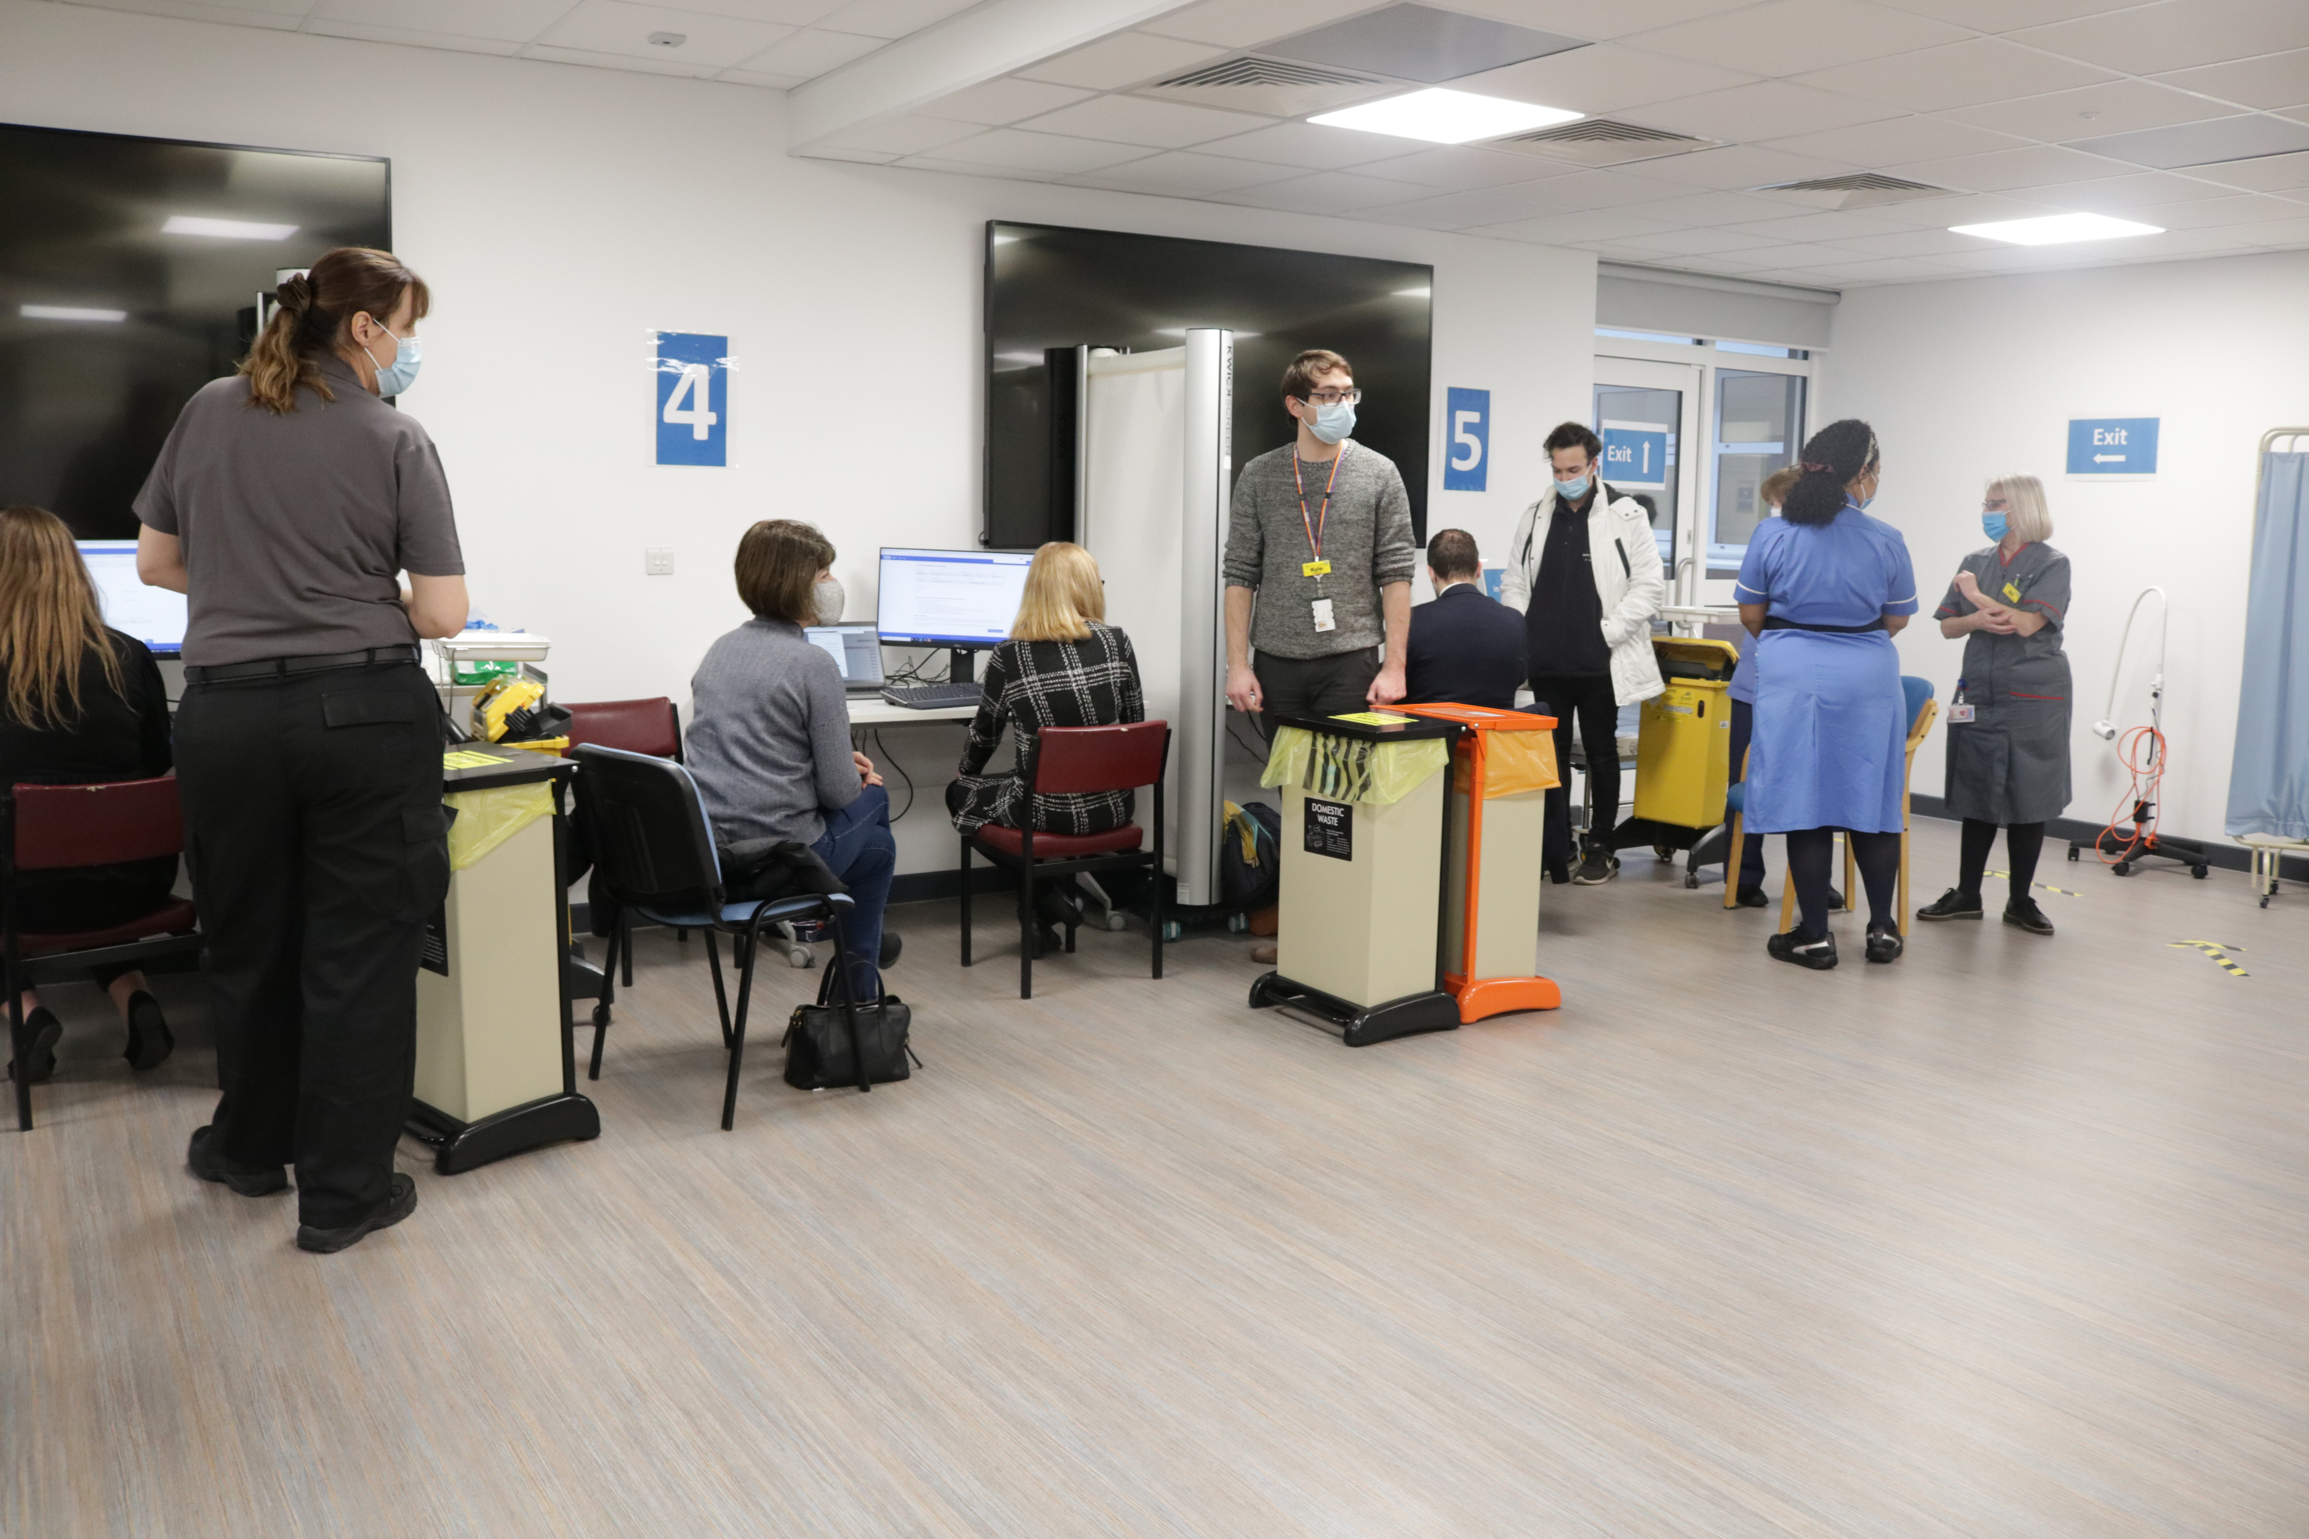
COVID-19 - Vaccinations
Trust participated in an extensive vaccination programme across both sites

Slide 19
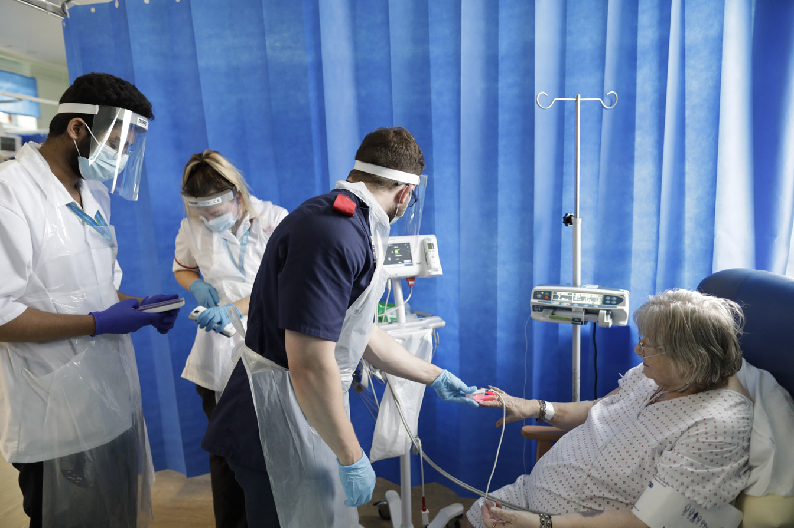
COVID-19 - Impact
Visiting rules
Patients/Carers on site
Infection Control processes to maintain safety
Social distancing

Slide 20
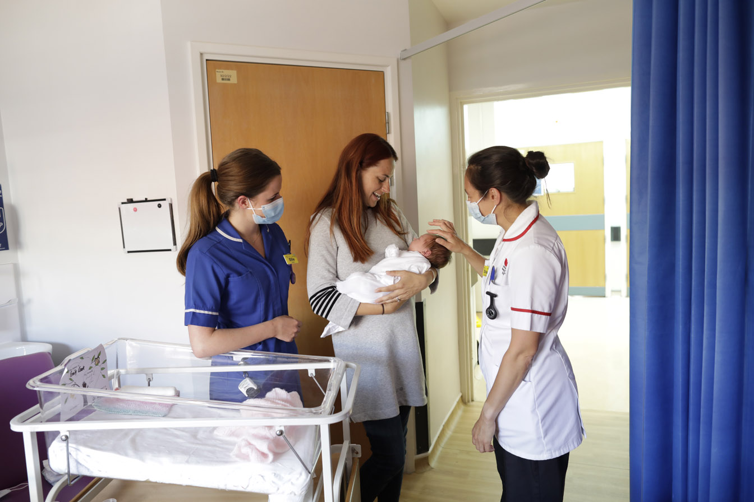
Maternity CQC Report
Report November 2020 – rated inadequate for the Bedford site
Team put in place an improvement programme
Revisit by CQC June 2021 demonstrated significant improvements
Ongoing monitoring in place at the Quality Committee
Working with L&D site to learn from the assessment
Next slide – David Hartshorne, Director of Redevelopment

Slide 21
Redevelopment
Full Business Case for the new clinical buildings at the L&D site to be submitted at end of September
Demolition work to clear site for the main works is underway to support main contractor access in January 22
Energy Centre construction is on programme for completion in July 22. Major elements of plant to be delivered in October
Survey work completed at Bedford site to support update of Development Control Plan
Urgent and Emergency Care programme complete at Bedford site. Major refurbishment work underway at the L&D site.

Slide 22
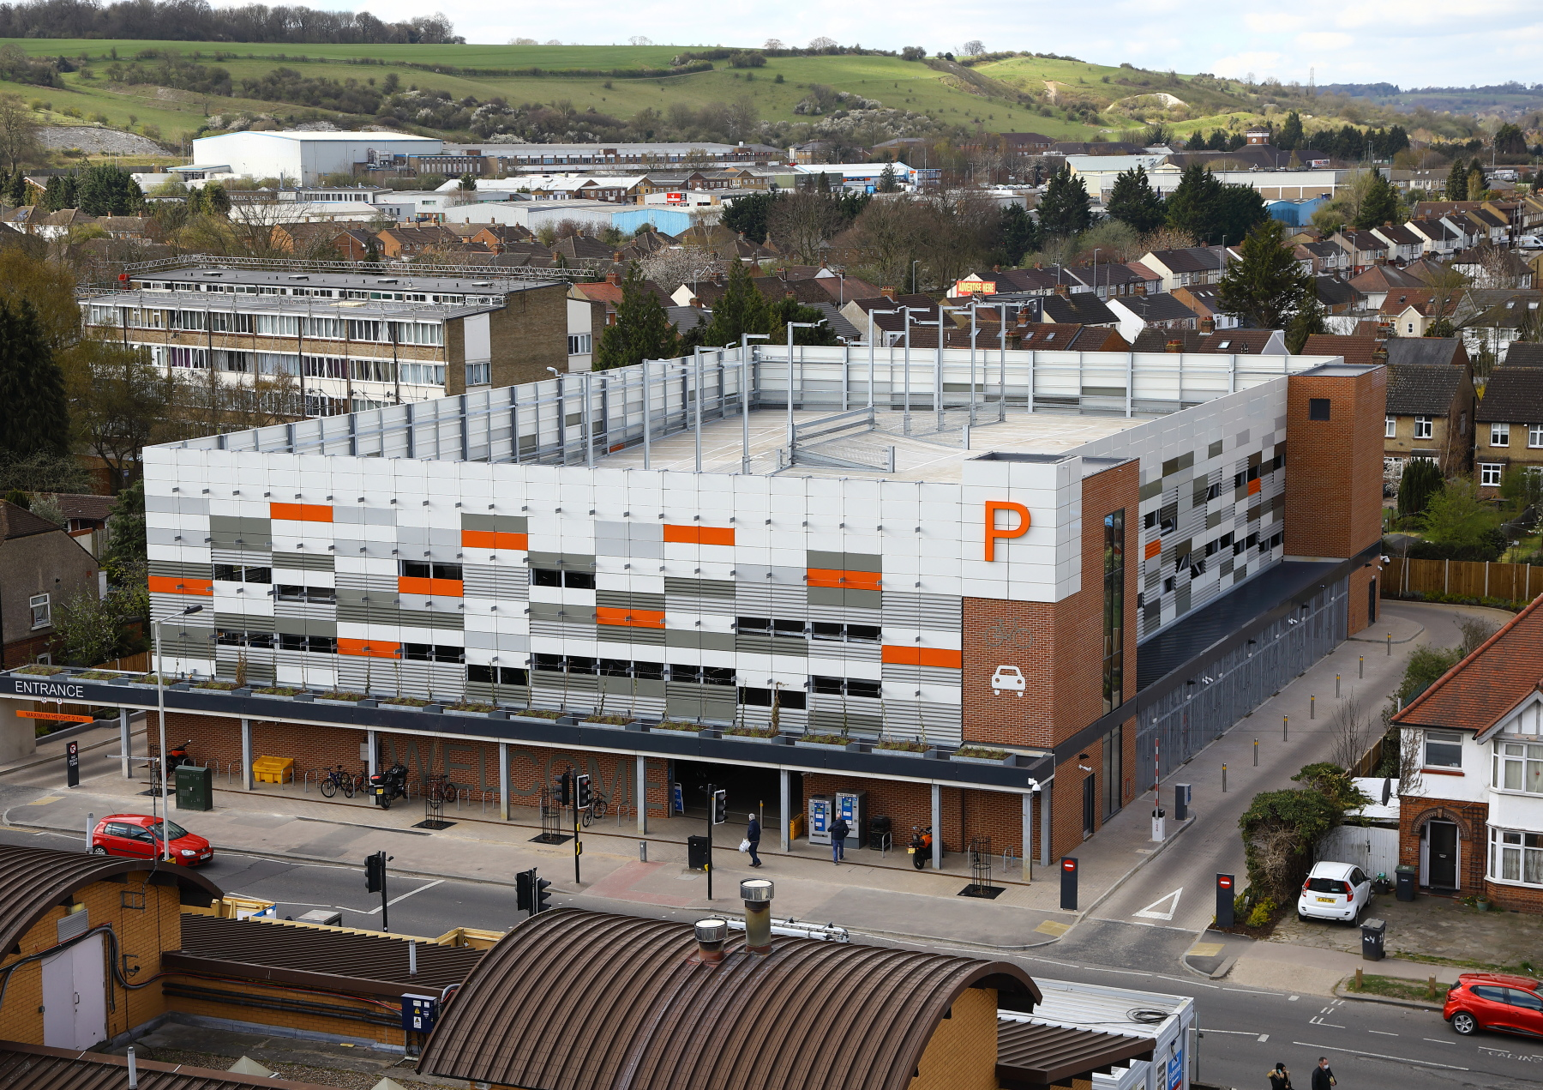
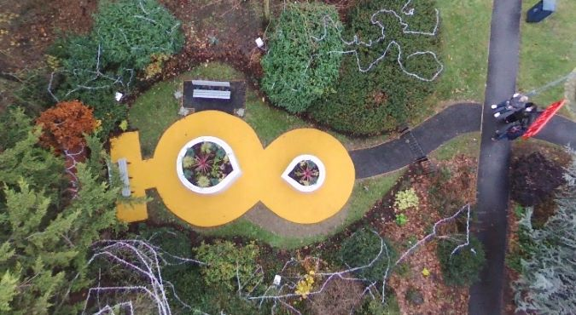
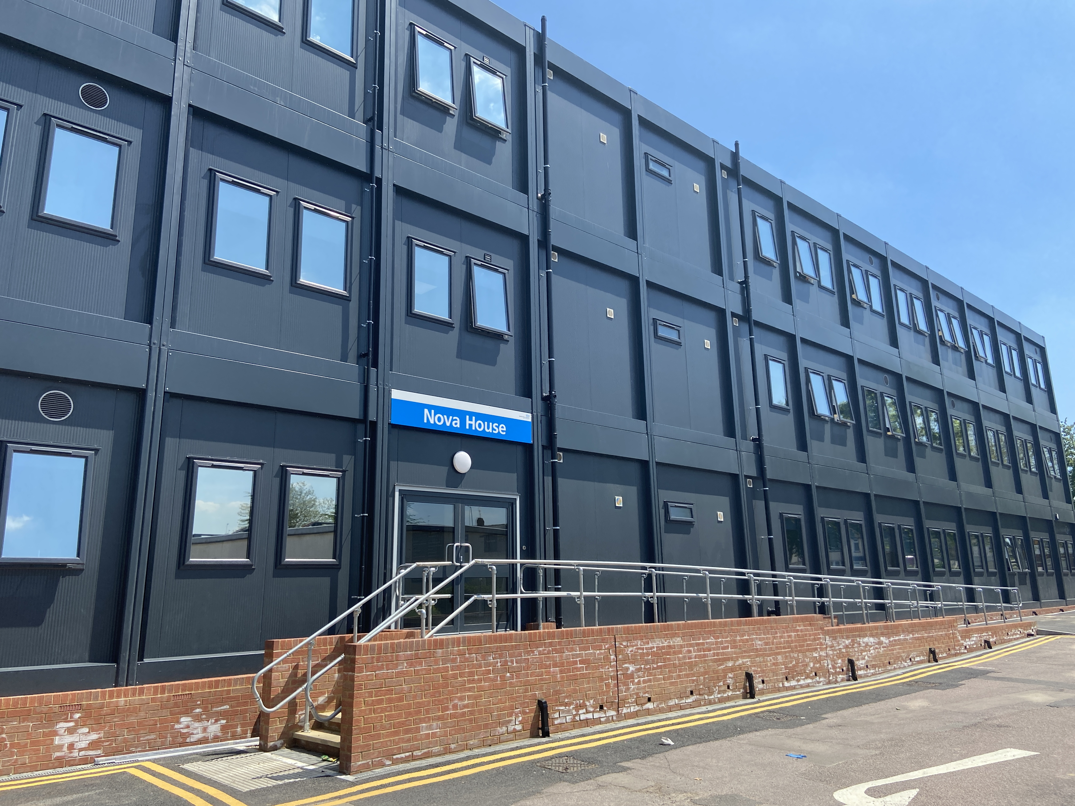
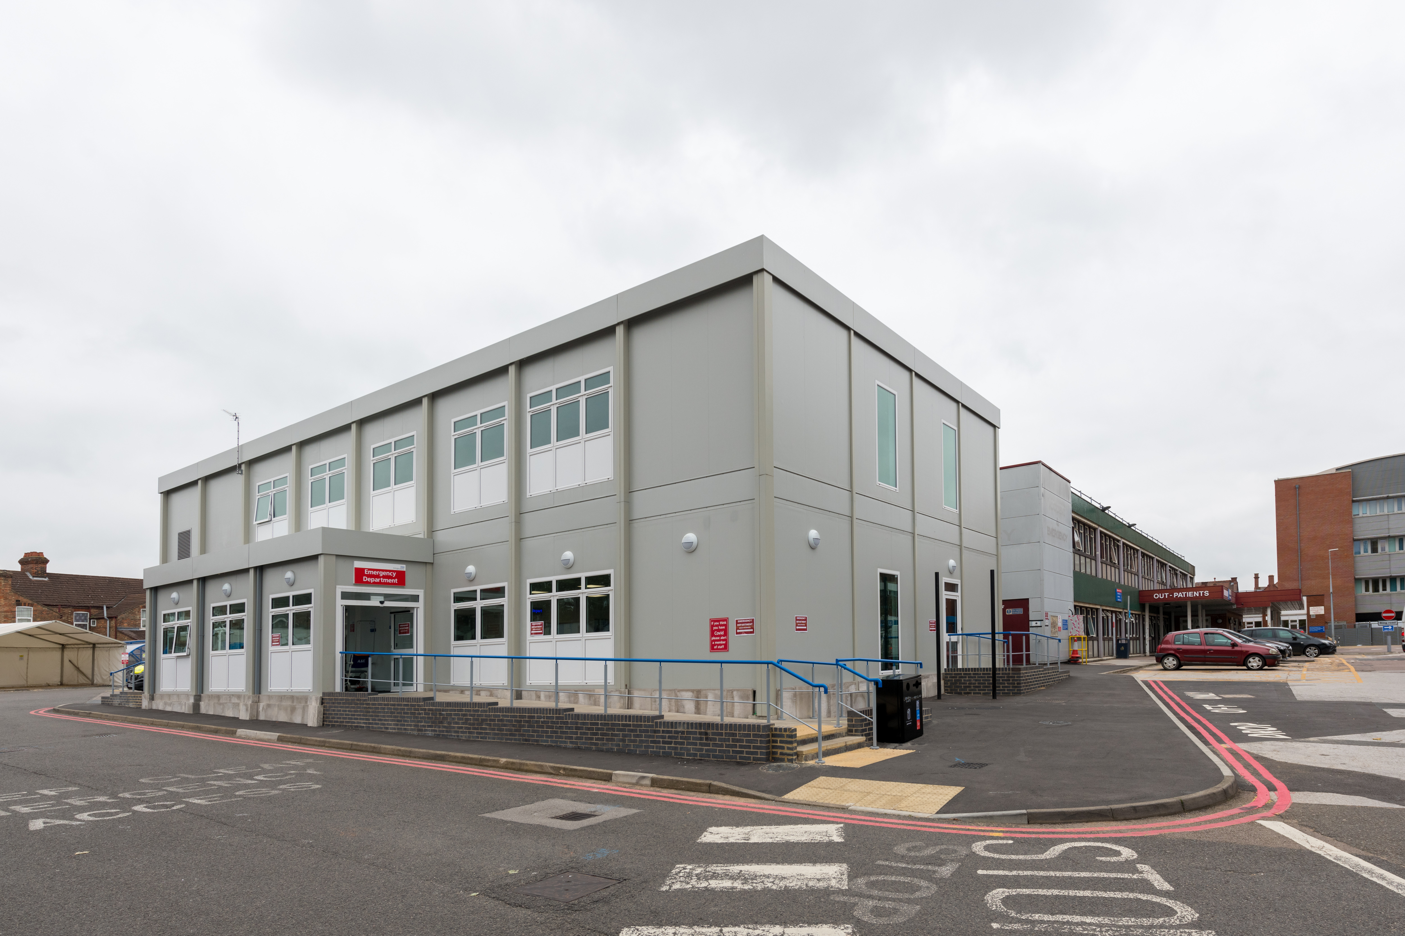
Redevelopment in pictures - Completed
Completed works on the Trust sites
Captain Sir Tom & Pamela Moore Dementia Garden at Bedford site
Lewsey Road Travel Hub at
L&D site
ED Extension at Bedford site
Nova House Office Block at L&D site

Slide 23
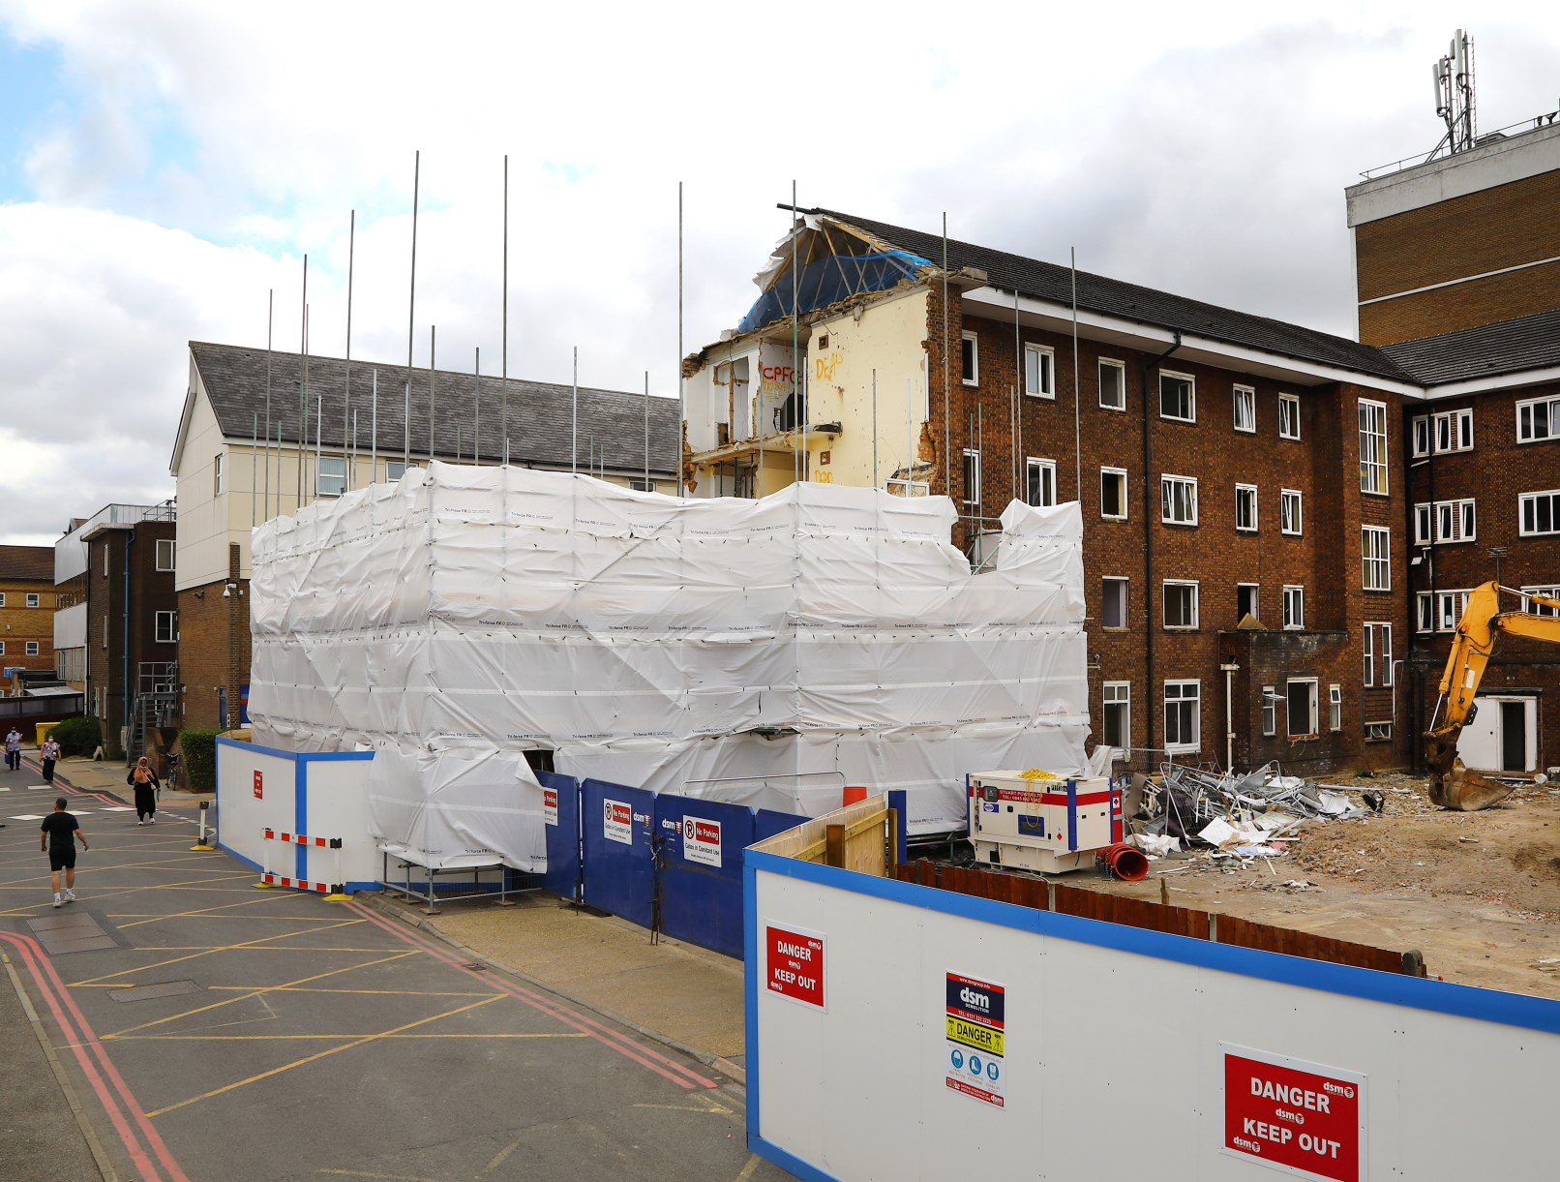
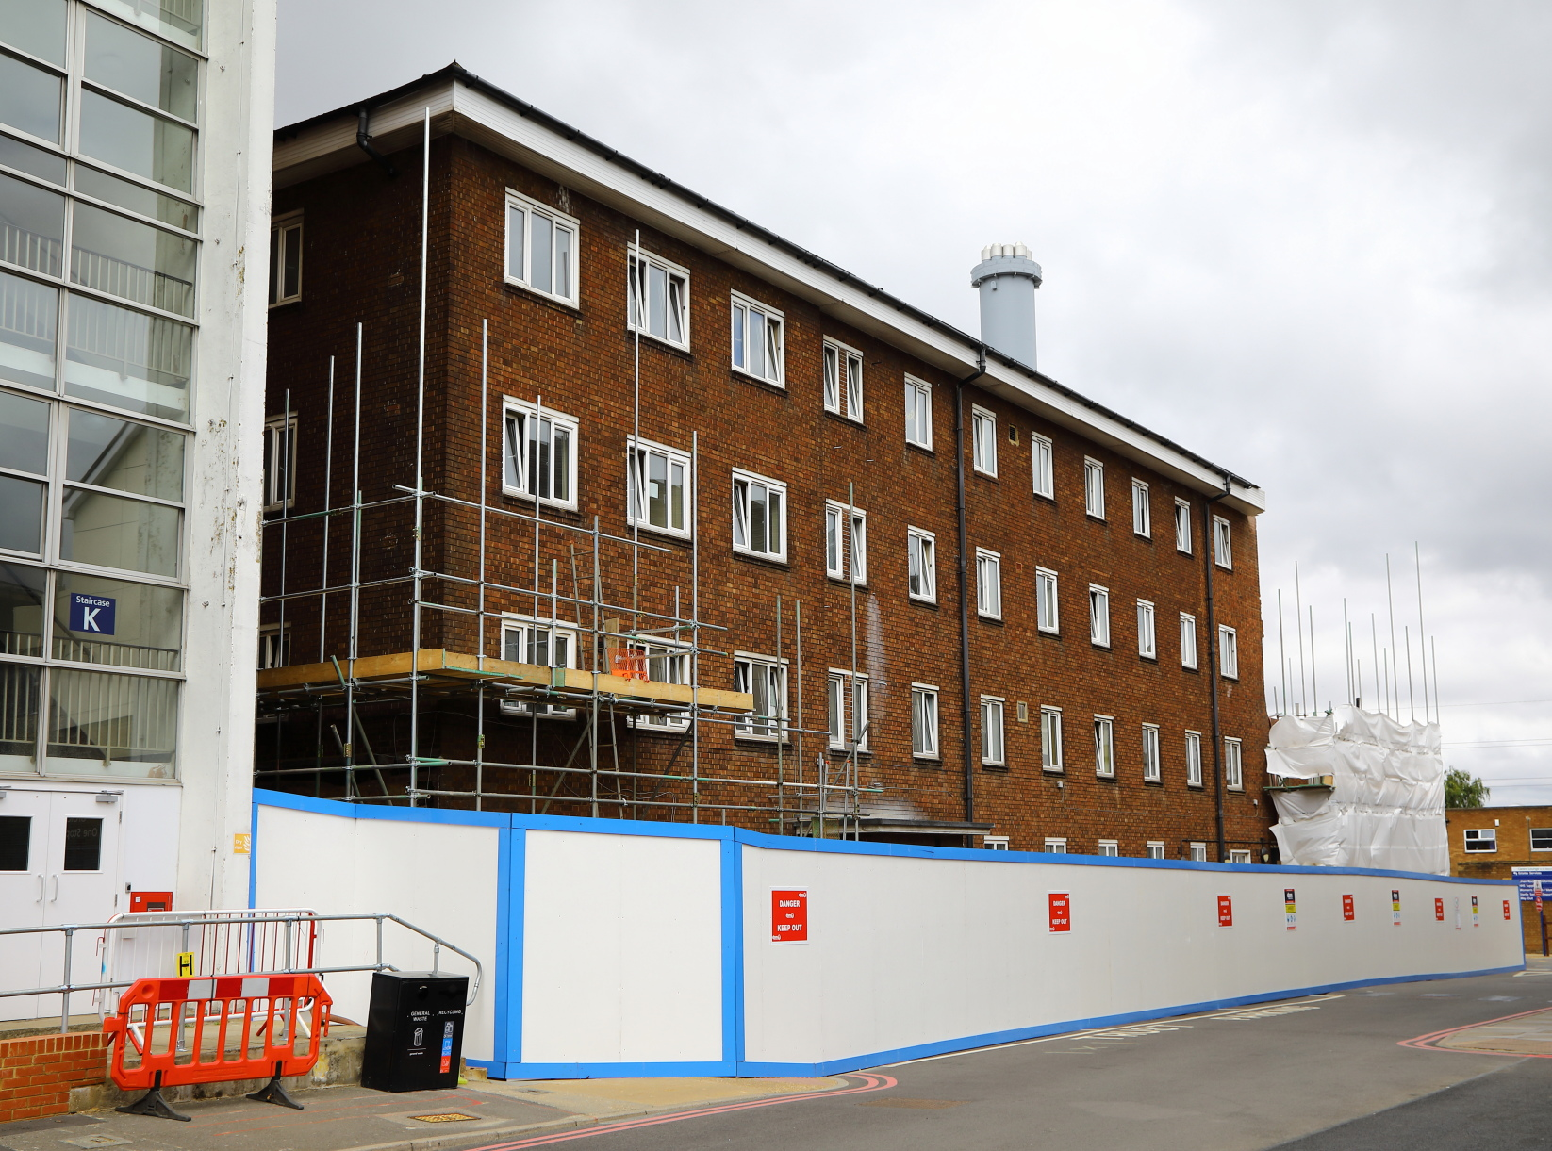
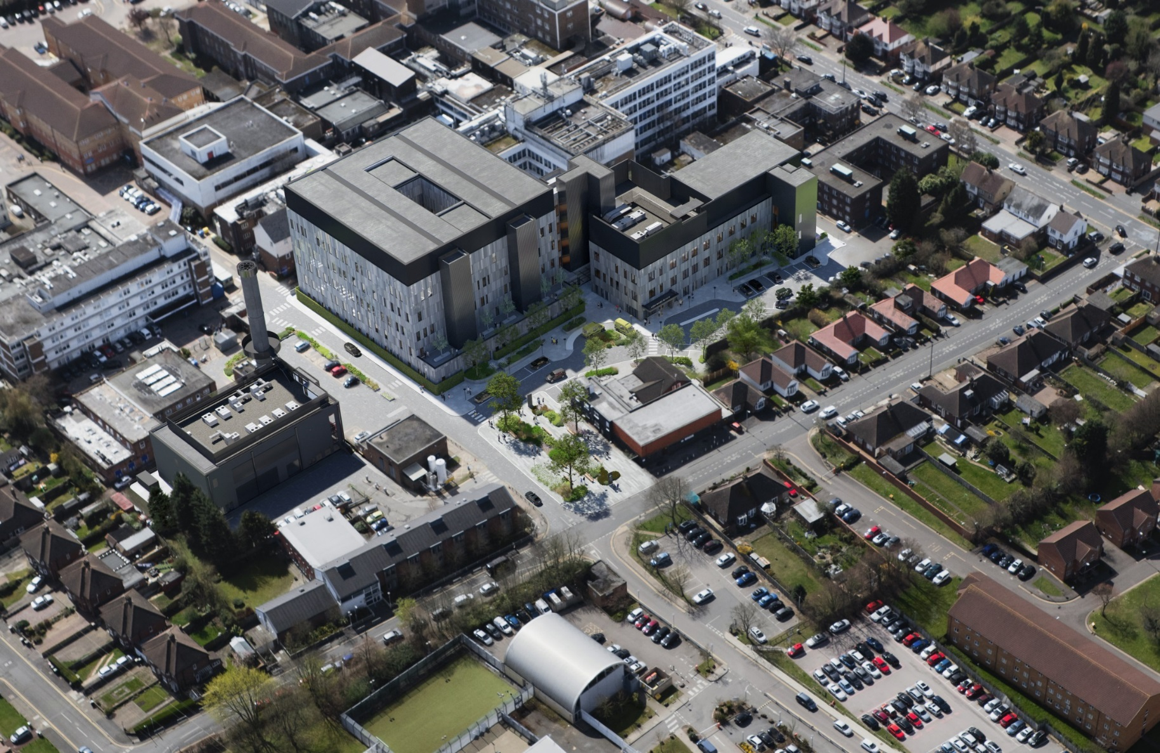
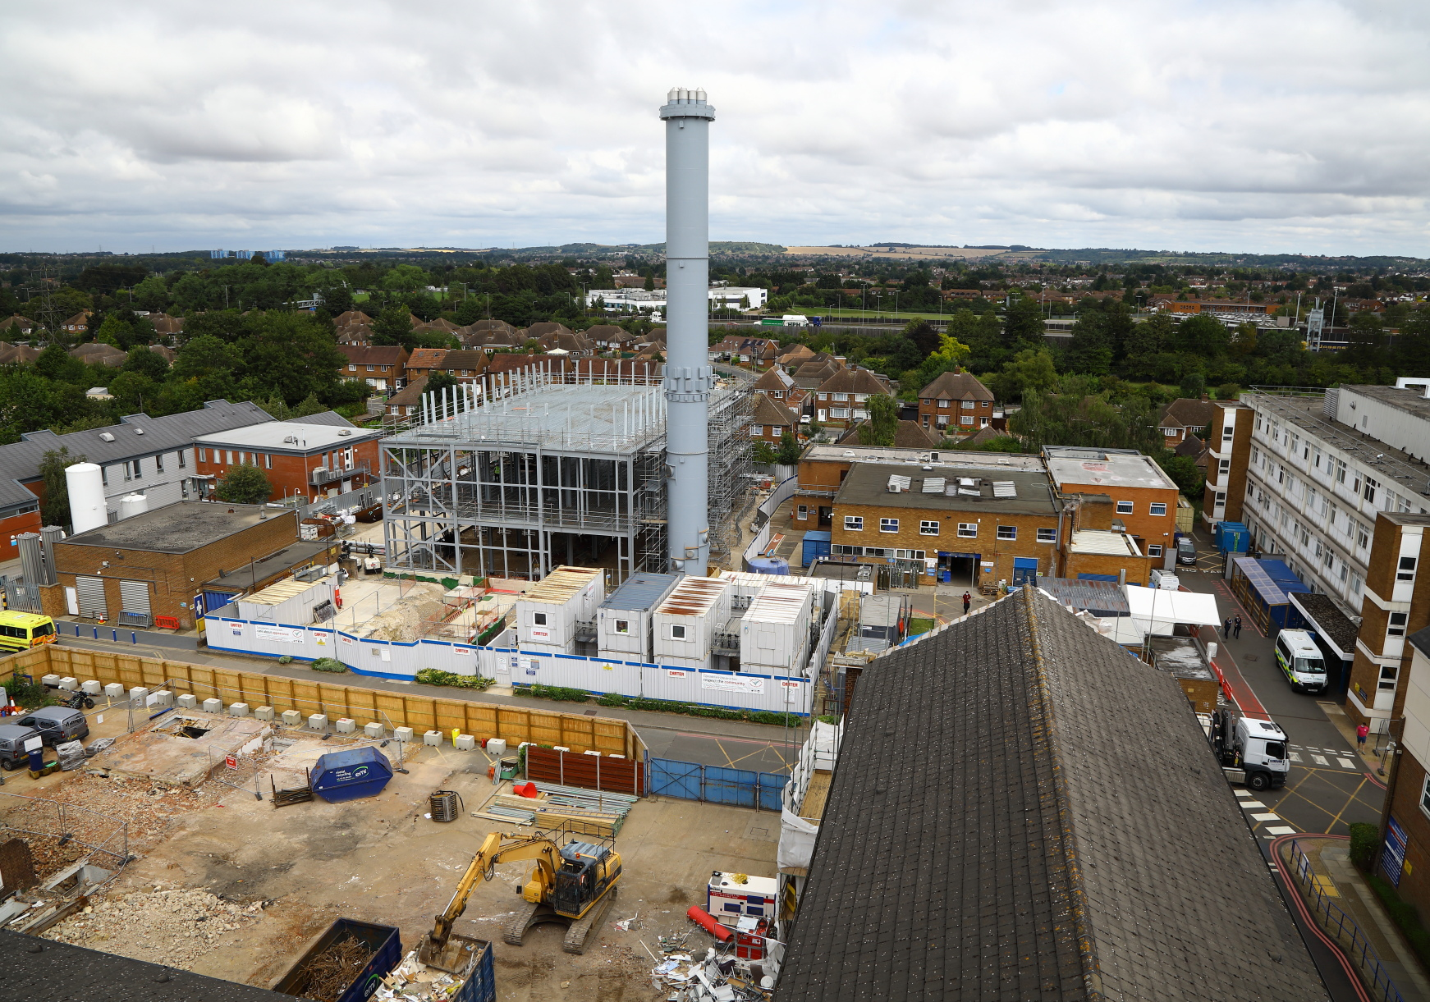
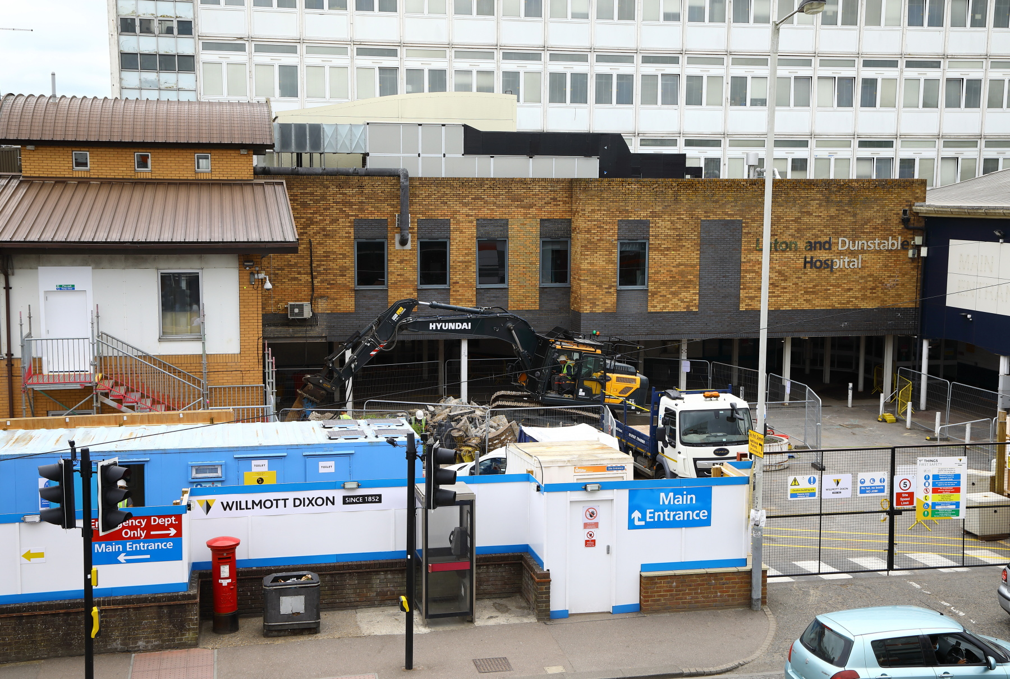
Redevelopment in pictures – In progress
Work on the the new Acute Services Block
Work towards the new Energy Centre
Work on the L&D ED
Next slide – David Carter, Chief Executive

Slide 24
Bedfordshire Hospitals NHS Foundation Trust 2021/22
Continued investment in the sites
Ongoing Clinically Led Integration Programme
Maintaining quality and financial performance
Recovery from COVID-19
Sustainability
Digital Integration

Slide 25
Looking to the future
Leading the Bedfordshire Care Alliance to shift from a reactive to proactive health system
The lead provider for the capitated budget for Bedfordshire
Leveraging our critical mass to deliver a reshaped primary and community care infrastructure
Part of multiple acute provider collaboratives with neighbours
An outstanding rating as an acute provider
Completing the redevelopment of both sites
Next slide – Simon Linnett, Chair

Slide 26
Report from the
Board of Directors
Simon Linnett
Chair
Please turn your camera OFF and MUTE your microphone (this will improve transmission quality and reduce background noise).

Slide 27
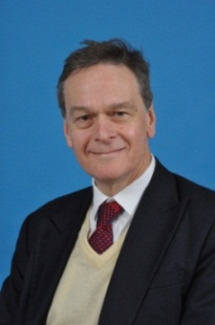
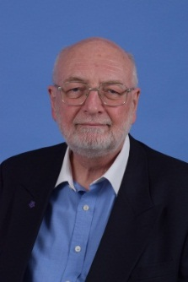
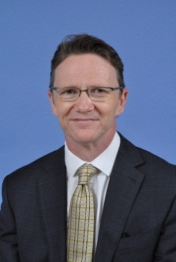
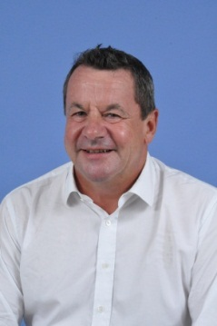
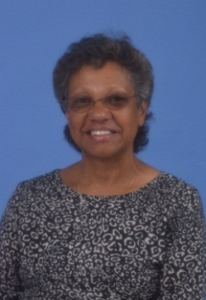
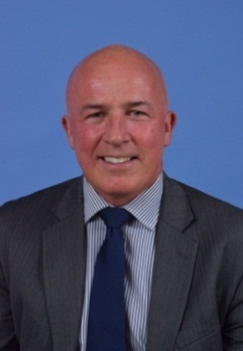
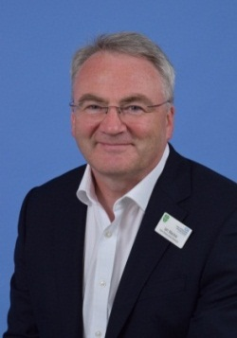
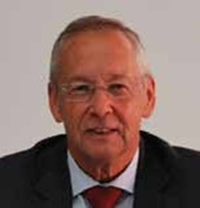
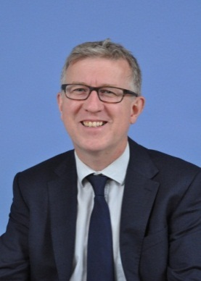
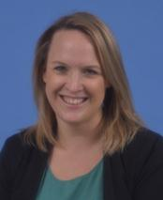
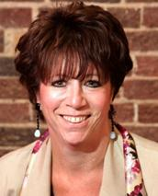
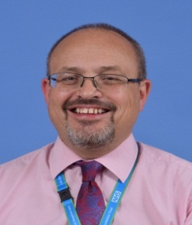
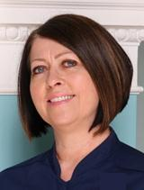
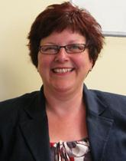
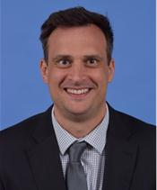
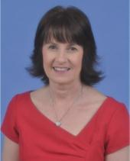
Our Board
The Board includes Executive and Non-Executive Directors
Non-Executive Directors
Simon Linnett
Chair
Gordon Johns Senior Independent Director
Simon Barton
Non-Executive
(Vice Chair)
Mark Prior
Non-Executive
Dr Annet Gamell
Non-Executive
Richard Mintern
Non-Executive
Ian Mackie
Non-Executive
Steve Hone
Non-Executive
Executive Directors
David Carter
Chief Executive
Cathy Jones
Deputy Chief
Executive
Dr Danielle Freedman
Joint Medical Director
Mr Paul Tisi
Joint Medical Director
Liz Lees MBE
Chief Nurse
Angela Doak
Director of Human Resources
Matthew Gibbons
Director of Finance
Catherine Thorne
Director of Quality & Safety Governance

Slide 28
Constitution Changes
Changes made to the Constitution to support the reduction plan in line with the merger Full Business Case (reducing the number of governors to 38).
Public Governor reduction plan.
To note that in Year 1 (2020) governor elections did not go ahead, and 8 governors were assigned the role of ‘non-voting governor’. The Year 1 reduction plan in line with the FBC was achieved by default by the appointment of the non-voting governors.
The Year 2 (2021) reduction plan was achieved as indicated in the chart below:
Constituency | Year 1 (2020) | Year 2 (2021) : Total number of Seats
Luton | 12 (3 non-voting) | 8
Central Bedfordshire | 7 (3 non-voting) | 6
Hertfordshire | 3 (1 non-voting) | 2
Bedford Borough (and surrounding counties -Cambs/Bucks./N’Shire) | 5 | 5
Total |  | 21

Slide 29
Constitution Changes
Staff Governor reduction plan.
That staff governors remain site-based except for the volunteer governor who will be Cross-site;
That the admin, clerical and management was grouped together with the ancillary and maintenance to create one ‘non-clinical’ staff constituency;
The reduction in the number of seats for the staff governors as indicated in the chart below:
The reduction plans for N&M (at L&D site) and Non-Clinical were implemented in Sep 2021;
Reduction plan for Volunteer (at cross-site) will be implemented in April 2023
Class | L&D Site | Bedford Site | Total Number of seats
Nursing and Midwifery | 2 | 1 | 3
Medical and Dental | 1 | 1 | 2
Professional and Technical | 1 | 1 | 2
Non-Clinical: Admin, Clerical, Managers, Ancillary & Maintenance | 2 | 2 | 4
Volunteer | 1 |  | 1
Total |  |  | 12

Slide 30
Report from the Governors
Helen Lucas
Lead Governor
Please turn your camera OFF and MUTE your microphone (this will improve transmission quality and reduce background noise).

Slide 31
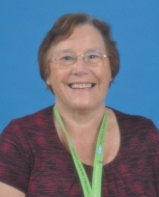
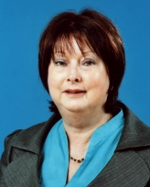
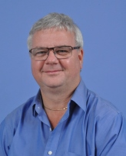
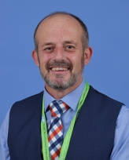
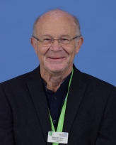
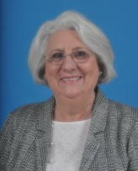
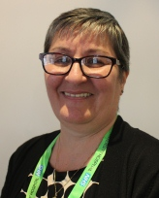
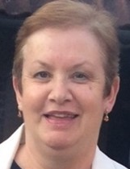
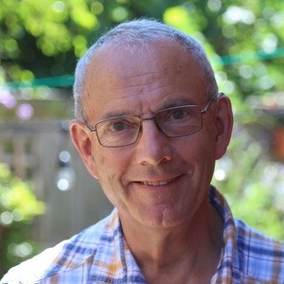





























Council of Governors
Pam Brown
Deputy Lead Gov
(Sept 19-22)
Marie-France Capon
(Sept 19-22)
Sean Driscoll
(Sept 19-22)
Brian Hertbert
(Sept 19-22)
Malcolm Lea
(Sept 19-22)
Judi Kingham,
(Sept 21-24)
Theresa Driscoll
(Sept 21-24)
Wendy Cook
(Sept 21-24)
Dr Michael Carter
(Sept 21-24)
Linda Grant
(Sept 21-24)
Jim Thakoordin
(Sept 21-24)
Jennifer Galluci
(Sept 21-24)
Pat Quartermaine
(Sept 21-23)
Debbie Gardiner MBE
(Sept 21-23)
Helen Lucas
Lead Gov.
(Sept 21-24)
Dr Dilan Joshi
(Sept 21-23)
Jacquie Farhoud
(April 20-23)
Teena Ferguson
(April 20-23)
Yvette King
(April 20-23)
Chris Williams
(April 20-23)
Dr Robert Oakley
(April 20—23)
Matthew Borg,
Nursing & Midwifery
(Sept 19-22)
Belinda Chik,
Nursing & Midwifery
(Sept 21-24)
Janet Graham
MBE, Volunteers
(Sept 21-April 23)
Sunny Patel,
Prof. & Technical
(Sept 19-22)
Malik Farooq,
Admin, Clerical &
Management
(Sept 19-22)
Hina Zafar,
Non clinical—Admin, Clerical, Management, Ancillary &
Maintenance (Sept 21-24)
Mr Dimpu Bhagawati
Medical & Dental
(Sept 21-24)
Noreen Byrne,
Volunteers
(April 20-23)
Thomas Moss
Ancillary & Maintenance
(April 20-23)
David Simms,
Nursing & Midwifery
(April 20-23)
Steve Morgan
Admin, Clerical
& Management
(April 20-23)
Mr Joby George Malal
Medical & Dental
(April 17-20)
Terrence Haynes-Smith
Prof. & Technical
(Sep 21-24)
Public - Luton
Public - Central Bedfordshire
Public - Bedford Borough and Surrounding Counties Public
Public - Hertfordshire
Dr Louise Grant
University of Beds
(April 20-23)
Cllr Charles Royden
Bedford Borough Council
(April 20-23)
Cllr Brian J Spurr
Central Beds Council
(May 20-23)
Cllr Javed Hussain
Luton Borough Council
(May 21– 24)
TBC
University College
London
Staff & Volunteers
Sept 2021
Appointed

Slide 32
New Governors
Dr Michael Carter
(Sept 21-24)
Public - Central Bedfordshire
Pat Quartermaine
(Sept 21-23)
Public - Central Bedfordshire
Debbie Gardiner MBE
(Sept 21-23)
Public - Central Bedfordshire
Wendy Cook
(Sept 21-24)
Public - Luton
Dr Dilan Joshi
(Sept 21-23)
Public - Hertfordshire
Mr Dimpu Bhagawati
Staff -Medical & Dental
(Sept 21-24)
Hina Zafar,
Staff - Non clinical: Admin, Clerical, Management, Ancillary&
Maintenance (Sept 21-24)
Terrence Haynes-Smith
Staff - Prof. & Technical
(Sep 21-24)
Cllr Javed Hussain
Luton Borough Council
(May 21– 24)

Slide 33
Holding the Non-Executive Directors (NEDs) to Account
Trust committees with Governor representation have a link NED
Governors feed into NED appraisals
Attending Board of Directors Meetings
NEDs attend Council of Governors meetings and make presentations
Sessions with NEDs and Council of Governors
Appointment of NEDs

Slide 34
Non-Executive Director Changes
Extended Simon Linnett as Chair to September 2022 for a final year
Extended Simon Barton and Mark Prior to Sep and Oct 2024, respectively
Extended Annett Gamell and Ian Mackie to June 2025
Resignation of Richard Mintern in August 2021 (to leave December 2021)
Recruitment process has begun for a Non-Executive and a Chair

Slide 35
Our Governors and Members
16,710 public members from Luton and Hertfordshire, Central Bedfordshire, Bedford (surrounding counties)
9,391 staff members across both hospital sites (including bank staff and volunteers)
38 Governors representing these members including 13 Staff Governors across both sites
5 appointed governors (3 councils and 2 universities)
The Governors:
  Represent the public, staff and stakeholders
  Support community engagement
  Hold the Non-Executive Directors to account
Achieved the reduction plan of the Governors during the year
Approved Interim Membership Strategy – focus on Bedford Borough and Central Bedfordshire

Slide 36
Elections 2021
Governor Election 2021: Public Constituencies
 | New | Leaving
Public: Luton | Judi Kingham (re-elected) Theresa Driscoll (re-elected) Wendy Cook (new) | David Allen (not elected) Keith Barter (not elected) Derek Smith (end of 9 years) Susan Doherty (end of 2nd term & 1 yr non-voting, did not stand)
Public: Central Bedfordshire | Linda Grant (re-elected) Dr Jim Thakoordin (re-elected) Jennifer Gallucci (re-elected) Dr Michael Carter (new) Pat Quartermain (new) Debbie Gardiner MBE (new) | Roger Turner (not elected) Dorothy Ferguson – Deputy Lead (end of 9 years) Matthew Towner (end of 1st term, did not stand)
Public: Hertfordshire | Helen Lucas – Lead Gov (re-elected) Dr Dilan Joshi (new) | Malcolm Rainbow (not elected) Don Atkinson (end of 2nd term, did not stand)
Public: Bedford Borough & Surrounding Counties | No Vacancies | N/A

Slide 37
Elections 2021
Governor Election 2021: Staff Constituencies and Appointed Governors
 | New | Leaving
Staff: Non Clinical - Admin Clerical, Mangers, Ancillary& Maintenance | Hina Zafar (elected unopposed – L&D) | Jacqueline McLaughlin (resigned)
Staff: Professional & Technical | Terrence Haynes-Smith (elected unopposed – Bedford) | N/A
Staff: Volunteers | Janet Graham MBE (elected unopposed L&D) | N/A
Staff: Medical & Dental | Mr Dimpu Bhagawati (new L&D) | Dr Ritwik Banerjee (end of 2nd term & 1 yr non-voting, did not stand)
Staff: Nursing and Midwifery | Belinda Chik (re-elected unopposed – L&D) | Ann Williams (end of 2nd term, did not stand)
Appointed: Luton Borough Council | Cllr Javed Hussain | Cllr Abbas Hussain

Slide 38
Thanks
Simon Linnett
Chair

Slide 39

Thanks to the Governors Leaving Us
Completed 9 Years
Dorothy Ferguson (Public - Central Bedfordshire & Deputy Lead Governor)
Derek Smith (Public - Luton)
Completed 8 years
Roger Turner - (Public - Central Bedfordshire) Plus 1 non voting
Completed 6 years
Susan Doherty (Public - Luton) Plus 1 non voting
Donald Atkinson (Public - Hertfordshire)
Ann Williams (Staff Nursing and Midwifery)
Dr Ritwik Banerjee (Staff Medical and Dental) plus 1 non voting
Completed 3 years
Malcolm Rainbow (Public - Hertfordshire) Plus 1 non voting
Keith Barter (Public - Luton)
David Allen (Public - Luton)
Matthew Towner (Public - Central Bedfordshire)
Next slide – Q&A, Simon Linnett, Chair

Slide 40
Questions and Answers
Simon Linnett
Chair

Slide 41

Question Time
Use the ‘Raise the hand’ icon
Use the Meeting ‘chat’ icon - Type using the ‘chat’ facility to ask a question.
Text your FULL NAME and QUESTION to 07812 493447
Disconnected? – If for some reason you are kicked
out of the meeting you can REJOIN

Slide 42

Question Time

Slide 43

Your feedback is important to us
We are keen to hear your feedback on the Annual Members’ Meeting and would be grateful if you could complete the questionnaire which will be emailed to you.

Slide 44

Encourage your family and friends to become public members – it’s free!
Email us at FTMembership@ldh.nhs.uk for a membership application form.
Use the QR code to sign up online. Scan the QR code below using your mobile device

