Slide 1
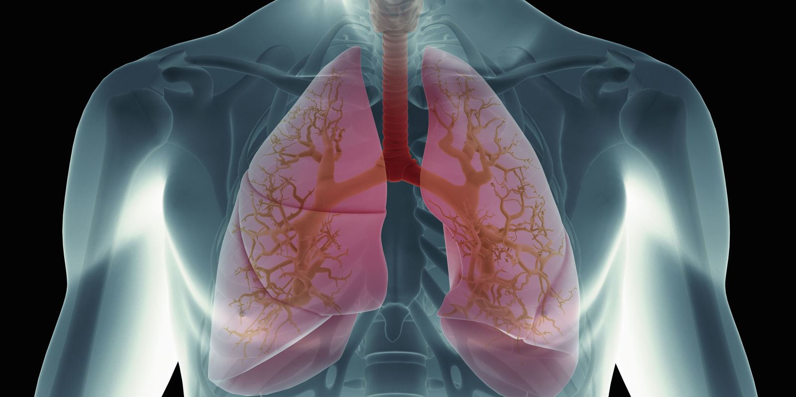
LUTON & SOUTH BEDS LOCAL PULMONARY FIBROSIS SUPPORT GROUP
Information and support group for patients, carers, friends and family affected by Pulmonary Fibrosis.
Dates: 1st Tuesday of every 2nd month,
starting @ 3pm-5pm on:
Venue: Peter Newton Pavillion, Skimpot Road, Dunstable, LU5 4AJ
Tuesday 1st October 2019
Tuesday 3rd December 2019
Tuesday 4th February 2020
Tuesday 7th April 2020
For more information please contact: Peter Bryce 07710424746 or email peter.bryce@pftrust.org
Helpline: 03000 030 555
Version 1.0 August 2018

